Slide 1

PROJECT ON
Exploratory Data Analysis on AMEO Dataset
MD JUNED ALAM
Id:-IN1240261
22th February 2023

Slide 2





About Me
I am an enthusiastic coder and an aspiring software engineer. I like to code and learn new skills(development),to improve my knowledge and skillset.
Passionate about leveraging technology and data-driven solutions to solve complex problems. I am a skilled professional with expertise in data structures and algorithms, Data Analytics ,Full -Stack web development , Python, Java, C, data science, and machine learning.
During my internship at MedTourEasy, I gained experienced the hands on working of a Data Analytics Professional and worked under the supervision of project mentor & developed the project entitled “Analyze Death Age Difference of Right Handers with Left Handers”. I am working on projects that involved data analysis, modeling, and predictive analytics. This opportunity honed my skills in extracting actionable insights from data .
Link to Project Repo: EDA on AMEO Project Dataset
Page | 2

Slide 3

I. OBJECTIVE OF THE PROJECT
This analysis aims to gain insights and understanding from the provided dataset, particularly focusing on the relationship between various features and the target variable, which is Salary.
Specifically, the goals of this analysis include:
To ensure the accuracy and consistency of our analysis, we converted the data types of the 'Date of Joining' (DOJ) and 'Date of Leaving' (DOL) fields from their original format to datetime objects. Given that the survey was conducted in 2015, the assumption was made that respondents who indicated their status as 'present' for DOL had left the company by the latest survey date, which was recorded as 2024-02-17. Therefore, we replaced the 'present' values in the DOL field with this end date.
Describing the dataset and its features comprehensively.
Identifying any patterns or trends
present in the data.
Exploring the relationships between independent and target variables (Salary).
Identifying any outliers or anomalies in the data.
B. Validating 0 or -1
Sr. No. | Column Name | Null Score
1 | Electronics&Semicon | 71.392341
2 | ComputerScience | 77.605884
3 | MechanicalEngg | 94.040071
4 | ElectricalEngg | 96.094344
5 | TelecomEngg | 90.565559
6 | CivilEngg | 98.934821
II. SUMMARY OF DATA
The Aspiring Mind Employment Outcome 2015 (AMEO) dataset, released by Aspiring Minds, focuses on employment outcomes for engineering graduates. It includes dependent variables such as Salary, Job Titles, and Job Locations, along with standardized scores in cognitive skills, technical skills, and personality
The data handling process has been
the
successfully completed. Firstly, columns '10board',
'12board',
skills. With around 40 independent variables and 4000 data points, these variables encompass both continuous and categorical data. The dataset also includes
'GraduationYear', 'JobCity', and 'Domain' were processed to replace null values represented by 0 or -1.
Following this, columns with over 80% -1
demographic features and unique identifiers for each candidate.
values, including 'MechanicalEngg', 'ElectricalEngg', 'TelecomEngg', and
'CivilEngg', were removed from further analysis.
Lastly, for the remaining optional subject columns, 'ElectronicsAndSemicon' and
III. DATA CLEANING AND PREPROCESSING
A. Datatype Conversion
'ComputerScience', -1 values were replaced with 0, indicating that the subjects were not pursued.
Page | 3

Slide 4

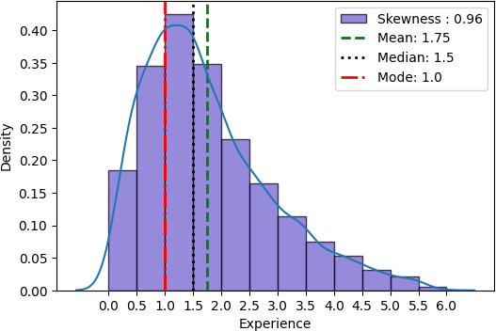
C. Collapsing Categories
Under this process, the dataset has been refined to encompass solely the top 10 most frequent categories within specific columns. Any categories beyond this selection have been categorized as other. This approach aims to streamline the dataset, focusing solely on the most prevalent categories for subsequent analysis.
IV. FEATURE ENGINEERING
distribution of the data, aiding in statistical analysis and decision-making processes.
def cdf(data):
x = np.sort(data) y = np.arange(1,
len(x)+1)/len(x) return x, y
V. EXPLORATORY DATA ANALYSIS
Age Calculation:
An additional column representing age has been incorporated into the dataset by subtracting the year of birth (DOB) from 2015, reflecting the individual's age as of 2015.
Tenure Calculation:
Another new feature, 'tenure', has been introduced by subtracting the 'Date of Leaving' (DOL) from the 'Date of Joining' (DOJ). This indicates the duration of an individual's employment within the company.
A. Univariate analysis
1. Continuous Features:
1.1. Tenure
Summary plots showcased a 4-year
experience range. Histograms displayed a positively skewed
distribution with a median tenure of 1.5 years and outliers signifying longer tenures. Box plots further emphasized
these outliers. Additionally, the
Cumulative Distribution Function (CDF) highlighted the non-normal distribution of tenure. These findings
Graduation Year Filtering:
Rows where the graduation year is greater than or equal to the date of joining have been removed. This ensures data integrity by excluding instances where the graduation year suggests a date after the individual's employment start date.
Cumulative Distribution Function (CDF) Function:
A custom function has been developed to calculate the Cumulative Distribution Function (CDF), allowing for the analysis of the distribution of a variable's values within the dataset. This function facilitates insights into the cumulative probability
provide valuable insights into workforce dynamics.
1.2 Salary
The
summary plot indicates
considerable variation, while the histogram reveals significant positive skewness, suggesting departure from
Page | 4

Slide 5

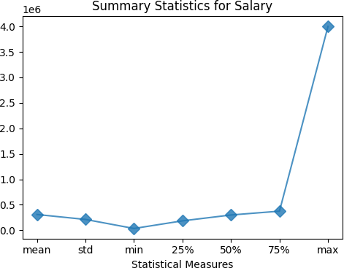
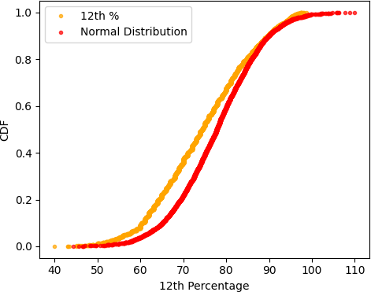
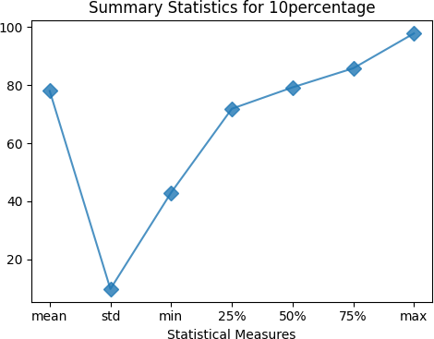
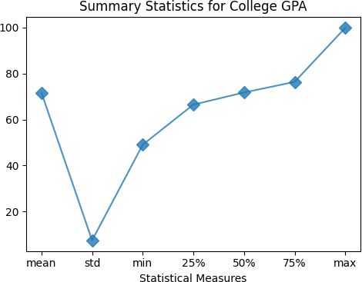
normal distribution. Box plots emphasize a concentration of high salaries. Furthermore, the cumulative
deviating from a normal distribution pattern.
1.4 12th Percentage
The dataset analysis shows that approximately half of the students scored around 78% or lower, with a scarcity of low scores. Most students scored between 69% and 84%, peaking at 70%. An outlier with an extremely low score is evident. The data deviates from a normal distribution pattern, as shown by the cumulative distribution function (CDF).
distribution underscores the
function
data's
(CDF)
skewness, a normal
deviating notably from distribution pattern.
1.3 10th Percentage
1.5 College GPA
Around half of the students achieved scores of approximately 80% or lower, as depicted by the summary plot. The histogram illustrates a scarcity of students with low percentages, with the majority falling within the 75% to 90% range, peaking at 78%. Extreme outliers are evident from the box plot, indicating some irregularities in the data distribution. Moreover, the
The analysis of student GPAs yields valuable insights. Approximately 75% of students had GPAs around 80% or lower, according to the summary plot. The histogram shows that most students
cumulative distribution function (CDF) highlights skewness in the data,
Page | 5

Slide 6

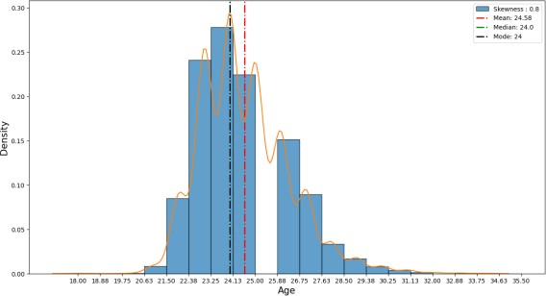
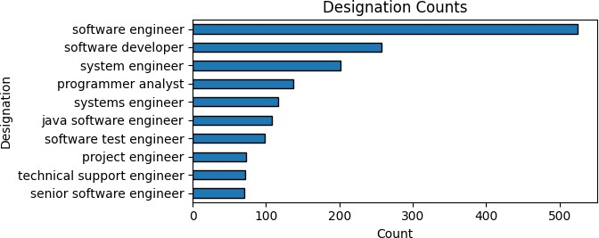
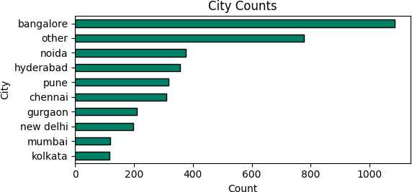
had GPAs between 63% and 78%, peaking at 70%, with an average GPA of 74%. Both low and high extreme values are apparent in the dataset, as indicated by the box plot. Interestingly, the cumulative distribution function (CDF) suggests that the data is
sufficiently normally distributed, contributing to its reliability for further analysis.
2. Categorical Features:
The dataset observations across various categories provide valuable insights into the demographics and educational backgrounds of individuals. In terms of Designation, Software Engineer emerges as the most prevalent designation, followed by System Engineer and Software Developer, with an "OTHER" category also present.
1.6 English, Logical, Quant, Computer Programming, Electronics & Semiconductors, Age
The dataset analysis across various subjects reveals distinct patterns. In English exams, approximately half of the students scored below 500, with scores predominantly ranging from 389 to 545 and a noticeable presence of extreme values. Similarly, in Logical exams, a significant portion of students scored below 500, with scores concentrated between 454 to 584, displaying both lower and higher extreme values. In Quants, a majority of students scored below 600, with scores spanning from 425 to 608, showing a mix of low and high extreme values. Conversely, in Computer Programming, around 50% of students scored below 500, with scores clustering between 416 to 459 and a notable presence of
Regarding Job City preferences, Bangalore stands out as the most favorable city for job placements, followed by Noida, Hyderabad, and Pune, while Mumbai and Kolkata are less preferred.
extreme values. Electronics and Semiconductors saw about 75% of students scoring less than 250, with scores mainly falling between 0 to 79 and a non-normal distribution evident. Lastly, the age distribution indicates that approximately 75% of students are under 26 years old, with the majority aged between 22 to 25 and notable outliers at both ends of the age spectrum.
Gender distribution highlights an imbalance, with a significantly larger male population compared to females.
Page | 6

Slide 7

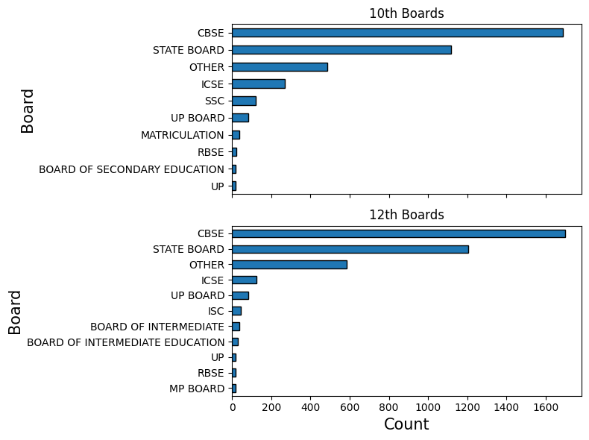
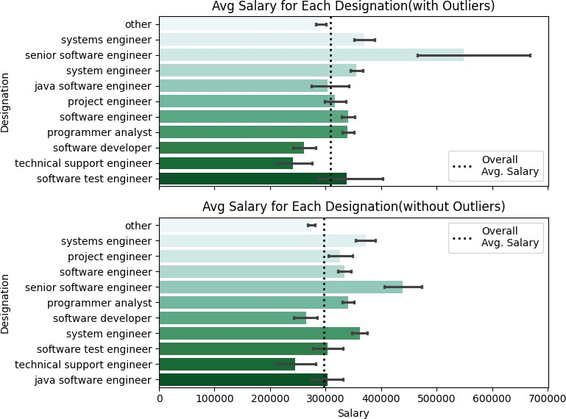
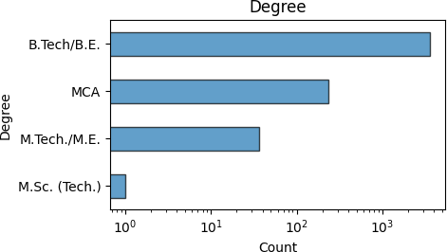
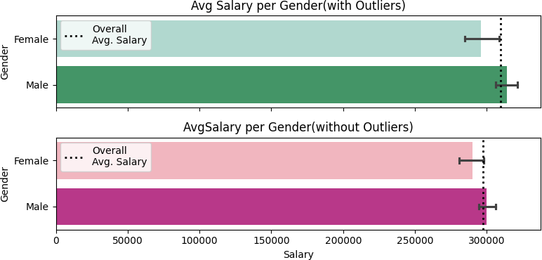
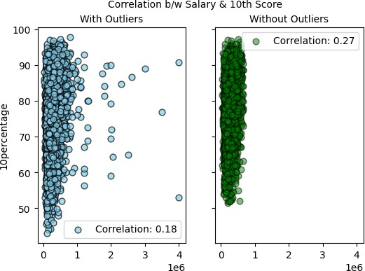
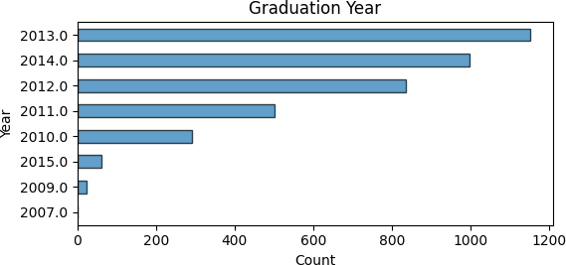
CBSE emerges as the most common school board for both 10th and 12th grades, while College Tier analysis indicates a dominance of Tier 1 colleges. Most students have pursued a B.Tech degree, with minimal representation from M.Sc(Tech) graduates.
Senior Software Engineers have the highest salary, but also the highest
standard deviation. Software Developers and Technical Support Engineers have salaries below the average.
2. Gender & Salary
The majority of colleges are located in Tier 0 cities, and 2013 saw the highest number of graduations, followed by 2014 and 2012. These observations collectively offer valuable insights into the educational and professional landscape captured by the dataset.
Both male and female salaries are
approximately equal on average, suggesting no gender bias overall, though females tend to receive salaries below the overall average.
3. Academic Scores & Salary
B. Bivariate analysis
1. Designations & Salary
Page | 7

Slide 8

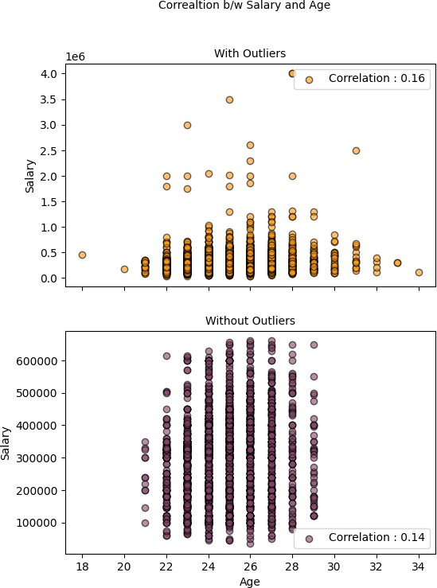
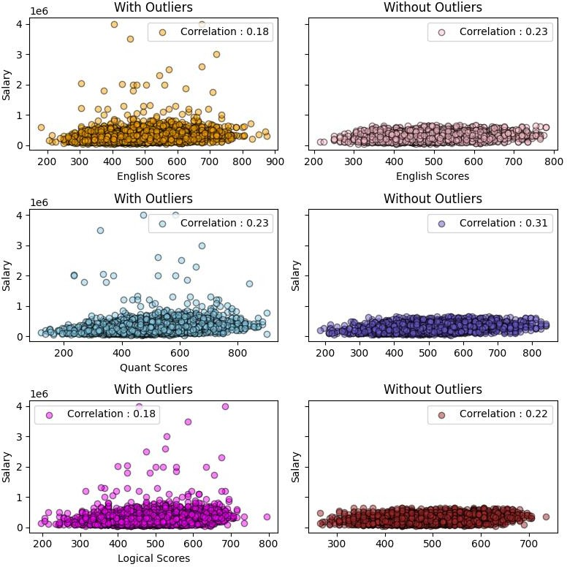
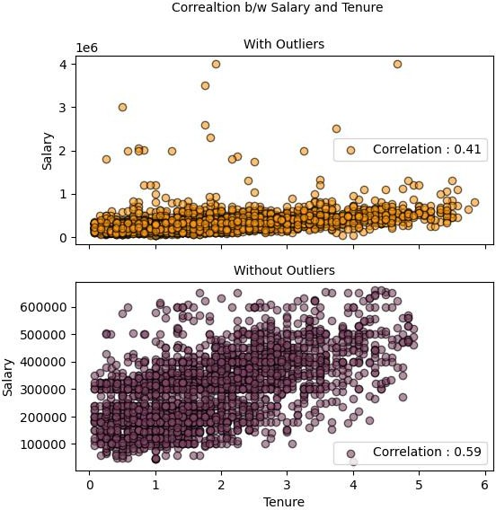
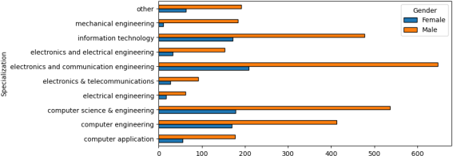
There is no significant correlation between salary and scores in 10th, 12th, or College GPA.
There's a positive correlation
between tenure and salary, with approximately a 50% salary increase with tenure, suggesting experience plays a role.
6. Skills & Salary
There's no apparent effect of English, Quants, or Logical scores on salary.
4. Age & Salary
There's no apparent relationship between age and salary after removing outliers.
7. Gender & Specialization
Male participation is approximately
double that of females across all specializations, with fewer females opting for mechanical and electronics.
5. Tenure & Salary
8. College Factors & Salary
Tier 1 colleges offer higher salaries compared to Tier 2 colleges, and cities in Tier 1 and Tier 2 offer similar salaries to students.
Page | 8

Slide 9

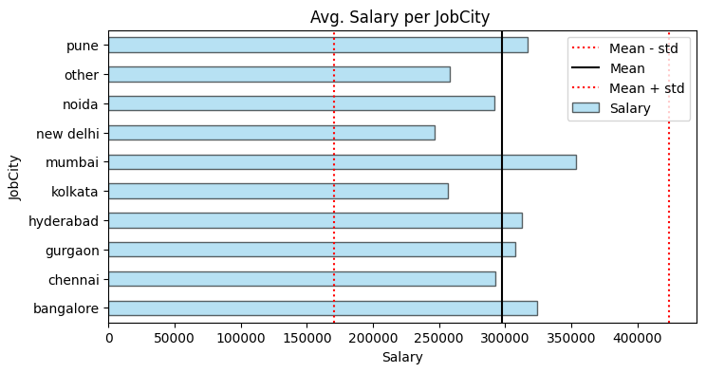
highest mean salary and standard deviation,
indicating both higher earnings and variability in pay compared to Programmer Analysts and Associate Engineers.
Following this, a one-sample t-test is conducted for each job designation to compare their average salary against an expected range. For Programmer Analysts and Software Engineers, the test results show sufficient evidence to reject the null hypothesis, suggesting that their salaries significantly differ from the expected range. However, for Hardware Engineers and Associate Engineers, there is not enough evidence to reject the null hypothesis, indicating that their salaries may not significantly deviate from the expected range.
Overall, these analyses provide valuable insights into salary distributions among
In conclusion, while certain factors like tenure and college tier influence salary, others such as gender and academic scores show little to no correlation. Outliers in age were removed, suggesting age alone doesn't dictate salary. These observations imply a complex interplay of factors influencing salaries in the studied context.
VI. RESEARCH OUTCOMES
“Times of India article dated Jan 18, 2019 states that “After doing your Computer Science Engineering if you take up jobs as a Programming Analyst, Software
Engineer, Hardware Engineer and Associate Engineer you can earn up to 2.5- 3 lakhs as a fresh graduate.”
different job roles and help in
understanding the significance of salary differences within the dataset.
Designation | t | p | Result
Programmer Analyst | 12.77 | 2.20e- 18 | Reject Null Hypothesis
Software Engineer | 10.21 | 5.82e- 21 | Reject Null Hypothesis
Hardware Engineer | NaN | NaN | Not Enough Evidence
Associate Engineer | 0.61 | 0.30 | Not Enough Evidence
Is there a relationship between gender and specialization? (i.e. Does the preference of Specialisation depend on the Gender?)
Test | Value
chi2_critical | 16.918977604620448
chi2_statistic | 48.62141720904882
chi2_p_value | 1.9542895953348e-07
The analysis conducted using a Chi- Square test examined the relationship
between gender and specialization preferences. The test revealed a statistically significant relationship between the two variables, indicating that specialization preferences are dependent on gender.
The calculated chi2 statistic exceeded the critical value, and the p-value was
The analysis begins by grouping the dataset by job designation, calculating the mean and standard deviation of salaries for each job role. This provides insights into salary distribution across different designations. Notably, Software Engineers have the
Page | 9

Slide 10

significantly less than the chosen significance level, leading to the rejection of the null hypothesis. Therefore, there is sufficient evidence to conclude that gender and specialization are related, suggesting that certain fields may be more preferred or accessible to individuals of particular genders. This finding underscores the importance of considering gender diversity and inclusivity in various fields and highlights potential barriers or biases that may exist in certain specializations.
VII. CONCLUSION
The extensive data analysis yields several notable discoveries about the factors impacting pay levels in the dataset. While certain criteria, such as tenure and college level, have a strong link with compensation, others, such as gender and academic performance, have no relationship.
Senior Software Engineers demand the
greatest incomes, but with unpredictability, while
greater Software Support average.
Developers and Technical
Engineers make less than the
Gender does not appear to play a large impact in income determination on average, yet females do receive less than the total average salary. Academic performance, as measured by 10th, 12th, and college GPA scores, does not clearly correlate with pay levels. After removing outliers, age does not appear to be a determining factor in compensation.
Page | 10

Slide 11
pj6uhrajt
February 19, 2024
Analysis of AMEO Data
  Introduction
    Dataset Description
The Aspiring Mind Employment Outcome 2015 (AMEO) dataset, released by Aspiring Minds, focuses on employment outcomes for engineering graduates. It includes dependent variables such as Salary, Job Titles, and Job Locations, along with standardized scores in cognitive skills, technical skills, and personality skills. With around 40 independent variables and 4000 data points, these variables encompass both continuous and categorical data. The dataset also includes demographic features and unique identifiers for each candidate.
    Objective
The goal of this Exploratory Data Analysis (EDA) is to extensively investigate the provided dataset, with a particular emphasis on understanding the link between various variables and the target variable, Salary.
The key aims of this analysis include:
      Providing a detailed explanation of the dataset’s features.
      Find any observable patterns or trends in the data.
      Investigating the relationships between the independent factors and the target variable (salary).
      Identify any outliers or abnormalities in the dataset.
      Offering practical insights and recommendations based on the analysis.
1.2 Importing the data and dislaying the head, shape, descriptions, etc.
[ ]:
import pandas as pd
import numpy as np
pd.set_option('display.max_columns',100)
[ ]:
ameo_data = pd.read_csv('AMEO_data.csv')
df1 = ameo_data.copy() df1.head()
[ ]:
df1.info()
11

Slide 12
<class 'pandas.core.frame.DataFrame'> RangeIndex: 3998 entries, 0 to 3997 Data columns (total 39 columns):
# Column Non-Null Count
Dtype
Unnamed: 0
ID
Salary
DOJ
DOL
Designation
JobCity
Gender
DOB
10percentage
10board
12graduation
12percentage
12board
CollegeID
CollegeTier
Degree
Specialization
collegeGPA
CollegeCityID
CollegeCityTier
CollegeState
GraduationYear
English
Logical
Quant
Domain
ComputerProgramming
ElectronicsAndSemicon
ComputerScience
MechanicalEngg
ElectricalEngg
TelecomEngg
CivilEngg
conscientiousness
agreeableness
extraversion
nueroticism
3998 non-null
3998 non-null
3998 non-null
3998 non-null
3998 non-null
3998 non-null
3998 non-null
3998 non-null
3998 non-null
3998 non-null
3998 non-null
3998 non-null
3998 non-null
3998 non-null
3998 non-null
3998 non-null
3998 non-null
3998 non-null
3998 non-null
3998 non-null
3998 non-null
3998 non-null
3998 non-null
3998 non-null
3998 non-null
3998 non-null
3998 non-null
3998 non-null
3998 non-null
3998 non-null
3998 non-null
3998 non-null
3998 non-null
3998 non-null
3998 non-null
3998 non-null
3998 non-null
3998 non-null
object int64 int64 object object object object object object float64 object int64 float64 object int64 int64 object object float64 int64 int64 object int64 int64 int64 int64 float64 int64 int64 int64 int64 int64 int64 int64 float64 float64 float64 float64 float64
38 openess_to_experience 3998 non-null dtypes: float64(9), int64(18), object(12) memory usage: 1.2+ MB
12

Slide 13
[ ]:
df1.shape
[ ]: (3998, 39)
[ ]:
df1.isnull().sum()
[ ]:
df1.duplicated().sum()
[ ]: 0
[ ]:
df1.columns
[ ]: Index(['Unnamed: 0', 'ID', 'Salary', 'DOJ', 'DOL', 'Designation', 'JobCity', 'Gender', 'DOB', '10percentage', '10board', '12graduation', '12percentage', '12board', 'CollegeID', 'CollegeTier', 'Degree', 'Specialization', 'collegeGPA', 'CollegeCityID', 'CollegeCityTier', 'CollegeState', 'GraduationYear', 'English', 'Logical', 'Quant', 'Domain', 'ComputerProgramming', 'ElectronicsAndSemicon', 'ComputerScience', 'MechanicalEngg', 'ElectricalEngg', 'TelecomEngg', 'CivilEngg', 'conscientiousness', 'agreeableness', 'extraversion', 'nueroticism', 'openess_to_experience'],
dtype='object')
[ ]: df1.nunique()
[ ]: Unnamed: 0
ID
Salary DOJ DOL
Designation JobCity Gender
DOB
10percentage 10board 12graduation 12percentage 12board CollegeID CollegeTier Degree Specialization collegeGPA CollegeCityID CollegeCityTier CollegeState
1
3998
177
81
67
419
339
2
1872
851
275
16
801
340
1350
2
4
46
1282
1350
2
26
13

Slide 14
GraduationYear English Logical
Quant Domain
ComputerProgramming ElectronicsAndSemicon ComputerScience MechanicalEngg ElectricalEngg TelecomEngg
CivilEngg conscientiousness agreeableness extraversion nueroticism openess_to_experience dtype: int64
11
111
107
138
243
79
29
20
42
31
26
23
141
149
154
217
142
[ ]:
df1 = df1.drop(columns = ['Unnamed: 0', 'ID','CollegeID','CollegeCityID'])
df1.head()
1.2.1 Datatypes Conversion
1. DOL - Date of Leaving. The survey was conducted back in 2015 and therefore making an assumption that the respondents who responded as present for DOL actually left the company within 2015 only. So, we will replace present value in DOL with 2024-02-17.
Then we convert the datetype of DOJ and DOL to datetime.
[ ]:
df1['DOL'].replace('present','2015-12-31', inplace = True)
df1['DOL'] = pd.to_datetime(df1['DOL']) df1['DOJ'] = pd.to_datetime(df1['DOJ']) df1.head()
[ ]:
categorical = ['Designation','JobCity',␣
↪'Gender','10board','12board','CollegeTier','Degree',
'Specialization','CollegeCityTier','CollegeState']
for cat in categorical:
df1[cat] = df1[cat].astype('category')
[ ]:
df1.dtypes
2. Checking if the DOL (Date of leaving) is actually greater than DOJ (Date of joining).
[ ]:
dates = df1[(df1['DOL'] < df1['DOJ'])].shape[0]
print(f'DOL is earlier than DOJ for {dates} observations.')
14

Slide 15
print(df1.shape)
DOL is earlier than DOJ for 40 observations. (3998, 35)
These observations might be typos and hence we will drop those 40 rows.
[ ]:
df1 = df1.drop(df1[~(df1['DOL'] > df1['DOJ'])].index)
print(df1.shape)
(3943, 35)
3. Making the entries for Gender column more descriptive
[ ]:
df1['Gender'].replace({'f':'Female','m':'Male'}, inplace = True)
df1.head()
[ ]:
4. Validating if the results are in percentages and not in CGPA or otherwise.
print((df1['10percentage'] <=10).sum())
print((df1['12percentage'] <=10).sum()) print((df1['collegeGPA'] <=10).sum())
0
0
12
10percentage and 12percentage are fine but collegeGPA has 12 obvservations which need to be deal with.
[ ]:
df1.loc[df1['collegeGPA']<=10,'collegeGPA'].index
[ ]: Int64Index([7, 138, 788, 1419, 1439, 1767, 2151, 2229, 2293, 2662, 2691, 3308],
dtype='int64')
[ ]:
df1.loc[df1['collegeGPA']<=10,'collegeGPA'] = (df1.
↪loc[df1['collegeGPA']<=10,'collegeGPA']/10)*100
df1.head()
[ ]:
5. Validating if there exist 0 or -1 in the data
print((df1==0).sum()[(df1==0).sum() > 0])
CollegeCityTier 2761
GraduationYear 1 dtype: int64
[ ]:
(df1==-1).sum()[(df1==-1).sum()>0]/len(df1)*100
15

Slide 16
[ ]: Domain | 6.137459
ComputerProgramming | 21.836165
ElectronicsAndSemicon | 71.392341
ComputerScience | 77.605884
MechanicalEngg | 94.040071
ElectricalEngg | 96.094344
TelecomEngg | 90.565559
CivilEngg | 98.934821
dtype: float64
According to the description of the columns:
10board
12board
GraduationYear
JobCity
Domain
The above columns cannot have 0 or -1 as their inputs and hence they should be considered as null values and therefore imputed
The following columns describes subjects which are optional for the exam and that is why they have large number of -1(null values). Hence we will be dropping the columns out of analysis in which the percentage for -1 values is greater than or equal to 80% and for the rest of them, we will impute the values as zero.
Sr.No. Column Name Null Score
1 ElectronicsAndSemicon 71.392341
2 ComputerScience | 77.605884
3 MechanicalEngg | 94.040071
4 ElectricalEngg | 96.094344
5 TelecomEngg | 90.565559
6 CivilEngg | 98.934821
[ ]:
df1 = df1.drop(columns = ['MechanicalEngg', 'ElectricalEngg', 'TelecomEngg',␣
↪'CivilEngg'])
df1.head()
[ ]:
df1['10board'] = df1['10board'].astype(str)
df1['12board'] = df1['12board'].astype(str) df1['JobCity'] = df1['JobCity'].astype(str)
[ ]:
df1['10board'] = df1['10board'].replace({'0':np.nan})
df1['12board'] = df1['12board'].replace({'0':np.nan}) df1['GraduationYear'] = df1['GraduationYear'].replace({0:np.nan}) df1['JobCity'] = df1['JobCity'].replace({'-1':np.nan})
df1['Domain'] = df1['Domain'].replace({-1:np.nan})
16

Slide 17
df1['ElectronicsAndSemicon'] = df1['ElectronicsAndSemicon'].replace({-1:0}) df1['ComputerScience'] = df1['ComputerScience'].replace({-1:0}) df1['ComputerProgramming'] = df1['ComputerProgramming'].replace({-1:np.nan})
[ ]:
df1['10board'] = df1['10board'].astype('category')
df1['12board'] = df1['12board'].astype('category') df1['JobCity'] = df1['JobCity'].astype('category')
[ ]:
df1
Imputing categorical columns with mode values for their respective columns.
[ ]:
df1['10board'].fillna(df1['10board'].mode()[0], inplace = True)
df1['12board'].fillna(df1['12board'].mode()[0], inplace = True) df1['GraduationYear'].fillna(df1['GraduationYear'].mode()[0], inplace = True) df1['JobCity'].fillna(df1['JobCity'].mode()[0], inplace = True)
df1
Imputing the numerical columns with median values for their respective columns.
[ ]:
df1['Domain'].fillna(df1['Domain'].median(), inplace = True)
df1['ComputerProgramming'].fillna(df1['ComputerProgramming'].median(), inplace␣
↪= True)
df1.head()
[ ]:
6. Correcting string data in columns
def correct_string_data(data):
'''
Convert the textual categories to lower case
and remove the leading or trailing spaces if any.
'''
df1[data] = df1[data].str.lower().str.strip()
[ ]:
textual_columns =␣
↪['Designation','JobCity','10board','12board','Specialization','CollegeState']
[ ]:
for col in textual_columns:
print(f'Number of unique values in {col} with inconsistency : {df1[col].
↪nunique()}')
Number of unique values in Designation with inconsistency : 416 Number of unique values in JobCity with inconsistency : 337 Number of unique values in 10board with inconsistency : 274 Number of unique values in 12board with inconsistency : 339
17

Slide 18
Number of unique values in Specialization with inconsistency : 46 Number of unique values in CollegeState with inconsistency : 26
[ ]:
for col in textual_columns:
correct_string_data(col)
[ ]:
for col in textual_columns:
print(f'Number of unique values in {col} without inconsistency : {df1[col].
↪nunique()}')
Number of unique values in Designation without inconsistency : 416 Number of unique values in JobCity without inconsistency : 230 Number of unique values in 10board without inconsistency : 272 Number of unique values in 12board without inconsistency : 336 Number of unique values in Specialization without inconsistency : 46 Number of unique values in CollegeState without inconsistency : 26
Since the number of categories are large enough to deal with, we keep the top 10 categories.
1.2.2 Collapsing Categories
Keeping only the top 10 frequent categories and classifying others as other.
[ ]:
def collapsing_categories(df1, data):
for Designation in df1[data].unique():
min_count = df1[data].value_counts()[:10].min()
if df1[df1[data] == Designation][data].value_counts()[0] < min_count: df1.loc[df1[data] == Designation, data] = 'other'
[ ]:
for cols in textual_columns:
collapsing_categories(df1, cols)
[ ]:
for cols in textual_columns:
print('')
print('Top 10 categories in:', cols) print('') print(df1[cols].value_counts()) print('')
print('*'*100)
Top 10 categories in: Designation
other | 2259
software engineer | 535
software developer | 262
system engineer | 202
programmer analyst | 139
18

Slide 19
systems engineer | 117
java software engineer | 109
software test engineer | 100
project engineer | 76
technical support engineer | 73
senior software engineer | 71
Name: Designation, dtype: int64
********************************************************************************
********************
Top 10 categories in: JobCity bangalore 1109
other 807
noida 382
hyderabad 361
pune 322
chennai 310
gurgaon 212
new delhi 203
mumbai 119
kolkata 118
Name: JobCity, dtype: int64
********************************************************************************
********************
Top 10 categories in: 10board
cbse
state board other
icse ssc
up board matriculation rbse
board of secondary education up
Name: 10board, dtype: int64
1726
1140
498
276
121
85
38
21
20
18
********************************************************************************
********************
Top 10 categories in: 12board
cbse
1737
19

Slide 20
state board other
icse
up board isc
board of intermediate
board of intermediate education up
mp board rbse
Name: 12board, dtype: int64
1229
595
128
87
45
38
31
19
17
17
********************************************************************************
********************
Top 10 categories in: Specialization
electronics and communication engineering 865 computer science & engineering 731
information technology 654
computer engineering 593
other 268
computer application 241
mechanical engineering 201 electronics and electrical engineering 191 electronics & telecommunications 120
electrical engineering 79 Name: Specialization, dtype: int64
********************************************************************************
********************
Top 10 categories in: CollegeState uttar pradesh 902
other 772
karnataka 369
tamil nadu 363
telangana 312
maharashtra 257
andhra pradesh 222
west bengal 192
madhya pradesh 189
punjab 188
haryana 177
Name: CollegeState, dtype: int64
********************************************************************************

Slide 21
********************
[ ]:
df1
1.2.3 Feature Engineering
1. Since the dataset was release in 2015, we add a age column by subtracting DOB year from 2015. This will add the age as of 2015.
[ ]:
df1['DOB'] = pd.to_datetime(df1['DOB'])
df1['Age'] = 2015 - df1['DOB'].dt.year df1.head()
[ ]:
2. Adding a tenure column by subtracting the DOL from DOJ
delta = (df1['DOL'] - df1['DOJ'])
tenure = np.zeros(len(df1))
for i, date in enumerate(delta): tenure[i] = round(date.days/365,2)
df1['Tenure'] = tenure
3. Dropping the rows where the graduationyear is greater than or equal to date of joining
[ ]:
len(df1[(df1['GraduationYear'] > df1['DOJ'].dt.year)].index)
[ ]: 79
[ ]:
df1 = df1.drop(df1[(df1['GraduationYear'] > df1['DOJ'].dt.year)].index)
[ ]:
4. Function to calculate CDF
def cdf(data):
x = np.sort(data)
y = np.arange(1, len(x)+1)/len(x)
return x, y
  Univariate Analysis
    1. Continuous Features
[ ]:
import matplotlib.pyplot as plt
import seaborn as sns
import statsmodels.api as sm
%matplotlib inline
1.1 Tenure

Slide 22
[ ]: # Summary Plot
plt.figure(figsize=(5, 4))
df1['Tenure'].describe()[1:].plot(alpha = 0.8,
marker = 'D', markersize = 8) plt.title('Summary Statistics for Tenure') plt.xlabel('Statistical Measures')
plt.tight_layout() plt.show()
# Histogram
plt.figure(figsize = (6,4)) plt.hist(df1['Tenure'],
ec = 'k',
bins = np.arange(0, df1['Tenure'].max()+0.5, 0.5), color = 'slateblue',
alpha = 0.7,
label = f"Skewness : {round(df1['Tenure'].skew(),2)}", density = True)
plt.xticks(ticks = np.arange(0, df1['Tenure'].max()+0.5, 0.5)) plt.xlabel('Experience')
plt.ylabel('Density')
plt.axvline(df1['Tenure'].mean(), label = f"Mean: {round(df1['Tenure'].
↪mean(),2)}",
linestyle = '--',
color = 'green', linewidth = 2) plt.axvline(df1['Tenure'].median(), label = f"Median: {round(df1['Tenure'].
↪median(),2)}",
linestyle = ':',
color = 'k', linewidth = 2) plt.axvline(df1['Tenure'].mode()[0], label = f"Mode: {round(df1['Tenure'].
↪mode()[0],2)}"
, linestyle = '-.',
color = 'red', linewidth = 2) sns.kdeplot(df1['Tenure'])
plt.legend() plt.show()
# Box Plot
plt.figure(figsize=(5, 4)) sns.boxplot(df1['Tenure']) plt.xlabel('Tenure') plt.tight_layout() plt.show()

Slide 23
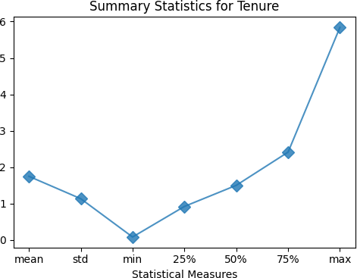
# CDF
plt.figure(figsize=(5, 4))
x_tenure, y_tenure = cdf(df1['Tenure'])
x_sample_tenure, y_sample_tenure = cdf(np.random.normal(df1['Tenure'].mean(),␣
↪df1['Tenure'].std(), size = len(df1['Tenure'])))
plt.plot(x_tenure, y_tenure, linestyle = 'None', marker = '.', color = 'orange',
alpha = 0.7, label = 'Tenure') plt.plot(x_sample_tenure, y_sample_tenure, linestyle = 'None',
marker ='.', color = 'red',
alpha = 0.7, label = 'Normal Distribution') plt.xlabel('Tenure')
plt.ylabel('CDF') plt.legend() plt.tight_layout() plt.show()

Slide 24
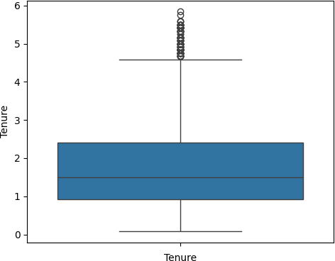

Slide 25
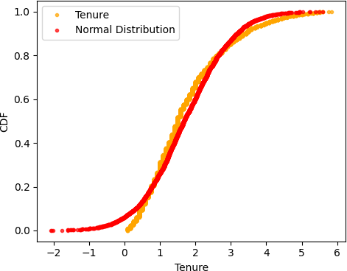
Sr.No. | Conclusion | Inferences
1. | Summary Plot | - The range for experience is 4
2. | Histogram | years. - The data is positively skewed i.e
 |  | there exists larger number of
 |  | respondents with low tenure, 50%
 |  | data points are below 1.5 years,
 |  | Average tenure is 1.5 years, The
 |  | mean, median, and mode lie very
 |  | close to each other and skewness (0.6) is close to that of a normal (0).
3.
4.
Box Plot
CDF
There are few values with large tenure i.e outliers
The data is not normally distributed, We can say that tenure is not normally distributed.
Observations
1.2 Salary

Slide 26
[ ]: # Summary Plot
plt.figure(figsize=(5,4)) df1['Salary'].describe()[1:].plot(alpha = 0.8,
marker = 'D', markersize = 8) plt.title('Summary Statistics for Salary') plt.xlabel('Statistical Measures')
plt.tight_layout() plt.show()
# Histogram
bins = np.arange(0, df1['Salary'].max()+250000, 250000) plt.figure(figsize = (10,6))
plt.hist(df1['Salary'], ec = 'k', bins = bins,
label = f"Skewness : {round(df1['Salary'].skew(),2)}", alpha = 0.7,
density = True) plt.xticks(bins) plt.xlabel('Salary', size = 15) plt.ylabel('Density', size = 15)
plt.axvline(df1['Salary'].mean(), label = f"Mean: {round(df1['Salary'].
↪mean(),2)}"
, linestyle = '-.',
color = 'red', linewidth = 2) plt.axvline(df1['Salary'].median(), label = f"Median: {round(df1['Salary'].
↪median(),2)}"
, linestyle = '-.',
color = 'green', linewidth = 2) plt.axvline(df1['Salary'].mode()[0], label = f"Mode: {round(df1['Salary'].
↪mode()[0],2)}"
, linestyle = '-.',
color = 'k', linewidth = 2) sns.kdeplot(df1['Salary']) plt.legend()
plt.show()
# Box Plot
plt.figure(figsize=(5,4)) sns.boxplot(df1['Salary']) plt.xlabel('Salary') plt.tight_layout() plt.show()

Slide 27
# CDF
plt.figure(figsize=(5,4))
x_salary, y_salary = cdf(df1['Salary']) x_sample_salary, y_sample_salary = \
cdf(np.random.normal(df1['Salary'].mean(), df1['Salary'].std(), size =␣
↪len(df1['Salary'])))
plt.plot(x_salary, y_salary, linestyle = 'None', marker = '.', color = 'orange',
alpha = 0.7, label = 'Tenure') plt.plot(x_sample_salary, y_sample_salary, linestyle = 'None',
marker ='.', color = 'red',
alpha = 0.7, label = 'Normal Distribution') plt.xlabel('Salary')
plt.ylabel('CDF') plt.legend() plt.tight_layout() plt.show()

Slide 28
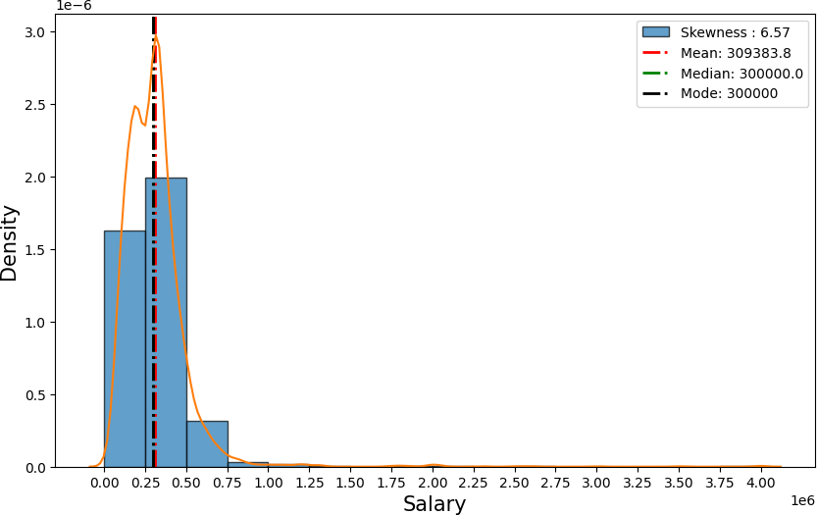
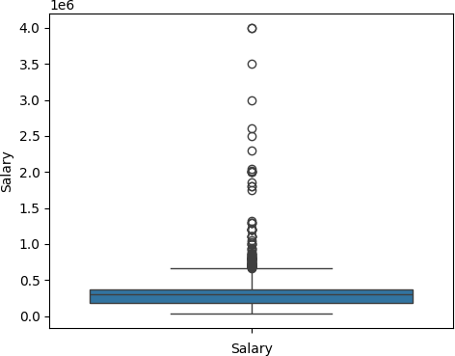

Slide 29
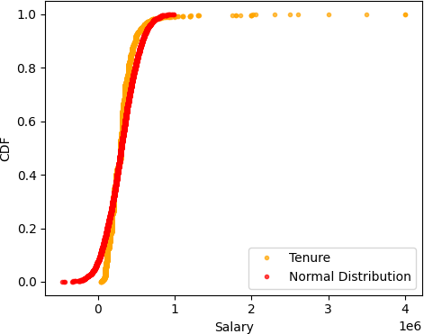
Conclusion
Inferences
Summary Plot
Histogram
There is substantial variation in salary across the dataset.
The data exhibits significant positive skewness, with a skewness value around 6 (approximately), indicating a departure from a normal distribution. The measures of central tendency (mean, median, and mode) are approximately equal.
There is a notable concentration of data points with high salaries, as depicted by the box plot.
The cumulative distribution function (CDF) reveals a high degree of skewness in the data, with considerable deviation from a normal distribution pattern.
3. Box Plot
4. CDF
Observations
1.3 10th Percentage

Slide 30
[ ]: # Summary Plot
plt.figure(figsize=(5,4)) df1['10percentage'].describe()[1:].plot(alpha = 0.8,
marker = 'D', markersize = 8) plt.title('Summary Statistics for 10percentage') plt.xlabel('Statistical Measures')
plt.tight_layout() plt.show()
#Histogram
bins = np.arange(df1['10percentage'].min(), df1['10percentage'].
↪max()+df1['10percentage'].std(),
df1['10percentage'].std()/3) plt.figure(figsize = (15,6)) plt.hist(df1['10percentage'], ec = 'k',
bins = bins,
label = f"Skewness : {round(df1['10percentage'].skew(),2)}", alpha = 0.7,
density = True) plt.xticks(bins)
plt.xlabel('10th Percentage', size = 15) plt.ylabel('Density', size = 15)
plt.axvline(df1['10percentage'].mean(), label = f"Mean:␣
↪{round(df1['10percentage'].mean(),2)}"
, linestyle = '-.',
color = 'red', linewidth = 2) plt.axvline(df1['10percentage'].median(), label = f"Median:␣
↪{round(df1['10percentage'].median(),2)}"
, linestyle = '-.',
color = 'green', linewidth = 2) plt.axvline(df1['10percentage'].mode()[0], label = f"Mode:␣
↪{round(df1['10percentage'].mode()[0],2)}"
, linestyle = '-.',
color = 'k', linewidth = 2) sns.kdeplot(df1['10percentage']) plt.legend()
plt.show()
#Box Plot
plt.figure(figsize=(5,4)) sns.boxplot(df1['10percentage']) plt.xlabel('10th percentage')

Slide 31
plt.tight_layout() plt.show()
# CDF
plt.figure(figsize=(5,4))
x_10, y_10 = cdf(df1['10percentage']) x_sample_10 , y_sample_10 = \
cdf(np.random.normal(df1['10percentage'].mean(), df1['10percentage'].std(),␣
↪size = len(df1['10percentage'])))
plt.plot(x_10, y_10, linestyle = 'None', marker = '.', color = 'orange', alpha = 0.7, label = '10th %')
plt.plot(x_sample_10, y_sample_10, linestyle = 'None', marker ='.', color = 'red',
alpha = 0.7, label = 'Normal Distribution') plt.xlabel('10th Percentage')
plt.ylabel('CDF') plt.legend() plt.tight_layout() plt.show()

Slide 32
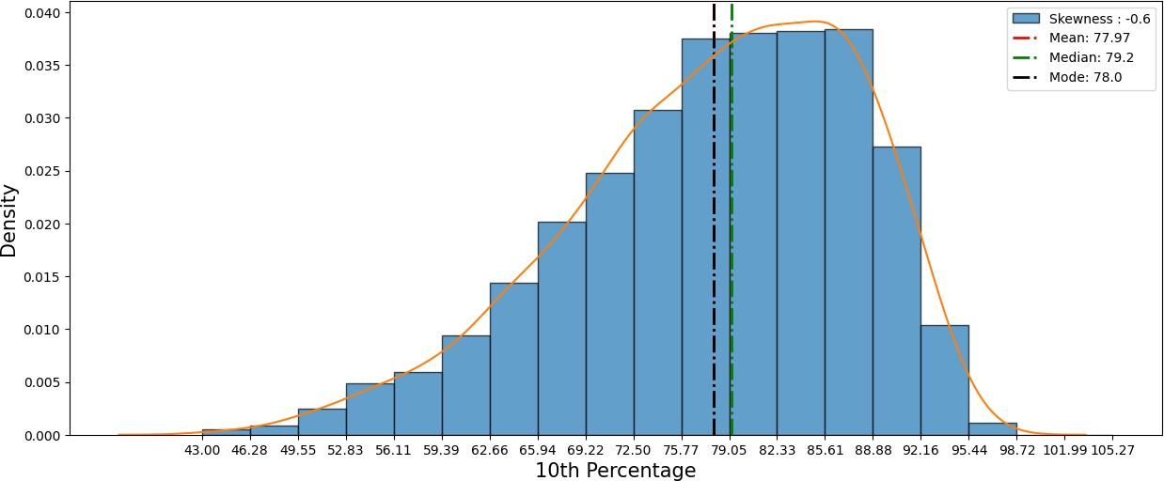
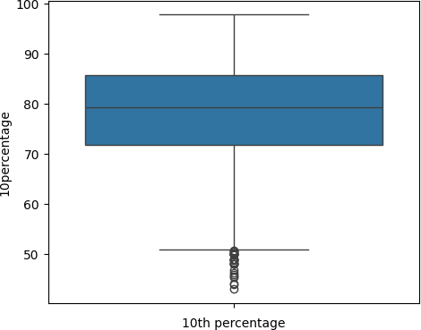

Slide 33
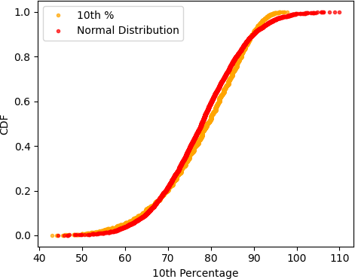
Conclusions
Inferences
Summary Plot
Histogram
Around 50% of students achieved scores of approximately 80% or less.
The histogram depicts a scarcity of students with low percentages, with the majority falling within the 75% to 90% range. The peak frequency occurs at 78%, and the average score hovers around 77%.
The presence of a few extreme outliers is evident from the box plot.
The data exhibits some skewness and does not conform to a normal distribution pattern.
Box Plot
CDF
Observations
1.4 12th Percentage
[ ]:
# Summary Plot
plt.figure(figsize=(5,4)) df1['12percentage'].describe()[1:].plot(alpha = 0.8,
marker = 'D', markersize = 8)

Slide 34
plt.title('Summary Statistics for 12percentage') plt.xlabel('Statistical Measures') plt.tight_layout()
plt.show()
# Histogram
bins = np.arange(df1['12percentage'].min(), df1['12percentage'].
↪max()+df1['12percentage'].std(),
df1['12percentage'].std()/3) plt.figure(figsize = (15,8)) plt.hist(df1['12percentage'], ec = 'k',
bins = bins,
label = f"Skewness : {round(df1['12percentage'].skew(),2)}", alpha = 0.7,
density = True) plt.xticks(bins)
plt.xlabel('12th Percentage', size = 15) plt.ylabel('Density', size = 15)
plt.axvline(df1['12percentage'].mean(), label = f"Mean:␣
↪{round(df1['12percentage'].mean(),2)}"
, linestyle = '-.',
color = 'red', linewidth = 2) plt.axvline(df1['12percentage'].median(), label = f"Median:␣
↪{round(df1['12percentage'].median(),2)}"
, linestyle = '-.',
color = 'green', linewidth = 2) plt.axvline(df1['12percentage'].mode()[0], label = f"Mode:␣
↪{round(df1['12percentage'].mode()[0],2)}"
, linestyle = '-.',
color = 'k', linewidth = 2) sns.kdeplot(df1['12percentage']) plt.legend()
plt.show()
#Box Plot
plt.figure(figsize=(5,4)) sns.boxplot(df1['12percentage']) plt.xlabel('12th percentage') plt.tight_layout()
plt.show()
# CDF
plt.figure(figsize=(5,4))

Slide 35
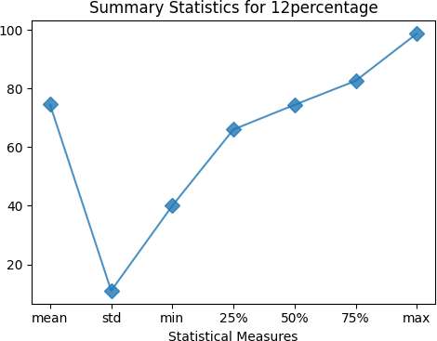
x_12, y_12 = cdf(df1['12percentage']) x_sample_12 , y_sample_12 = \
cdf(np.random.normal(df1['12percentage'].mean(), df1['12percentage'].std(),␣
↪size = len(df1['12percentage'])))
plt.plot(x_12, y_12, linestyle = 'None', marker = '.', color = 'orange', alpha = 0.7, label = '12th %')
plt.plot(x_sample_10, y_sample_10, linestyle = 'None', marker ='.', color = 'red',
alpha = 0.7, label = 'Normal Distribution') plt.xlabel('12th Percentage')
plt.ylabel('CDF') plt.legend() plt.tight_layout() plt.show()

Slide 36
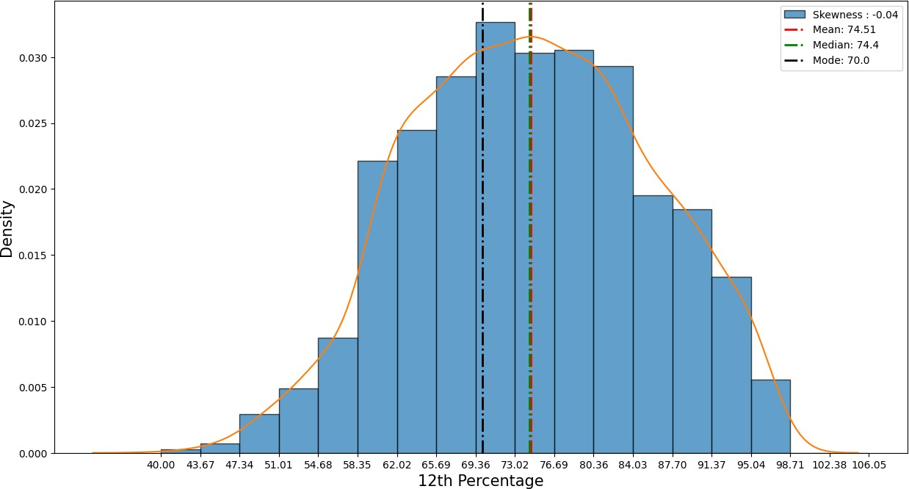
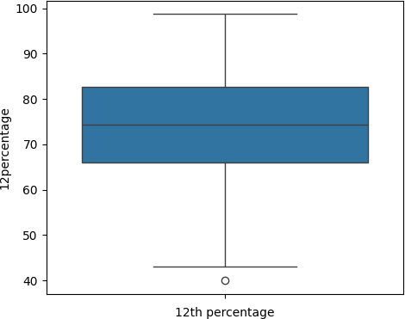

Slide 37
Conclusions
Inferences
Summary Plot
Histogram
Roughly half of the students achieved scores of approximately 78% or lower.
The histogram illustrates a scarcity of students with low percentages, with the majority scoring between 69% and 84%. The peak frequency occurs at 70%, and the average score is around 74%.
The box plot indicates only one data point with an extremely low score.
The data does not follow a normal distribution pattern.
Box Plot
CDF
Observations
1.5 CollegeGPA
[ ]:
#Summary Plot
plt.figure(figsize=(5,4)) df1['collegeGPA'].describe()[1:].plot(alpha = 0.8,
marker = 'D', markersize = 8)

Slide 38
plt.title('Summary Statistics for College GPA') plt.xlabel('Statistical Measures') plt.tight_layout()
plt.show()
# Histogram
bins = np.arange(df1['collegeGPA'].min(), df1['collegeGPA'].
↪max()+df1['collegeGPA'].std(),
df1['collegeGPA'].std()/2) plt.figure(figsize = (15,8)) plt.hist(df1['collegeGPA'], ec = 'k',
bins = bins,
label = f"Skewness : {round(df1['collegeGPA'].skew(),2)}", alpha = 0.7,
density = True) plt.xticks(bins)
plt.xlabel('College GPA', size = 15) plt.ylabel('Density', size = 15)
plt.axvline(df1['collegeGPA'].mean(), label = f"Mean: {round(df1['collegeGPA'].
↪mean(),2)}"
, linestyle = '-.',
color = 'red', linewidth = 2) plt.axvline(df1['collegeGPA'].median(), label = f"Median:␣
↪{round(df1['collegeGPA'].median(),2)}"
, linestyle = '-.',
color = 'green', linewidth = 2) plt.axvline(df1['collegeGPA'].mode()[0], label = f"Mode:␣
↪{round(df1['collegeGPA'].mode()[0],2)}"
, linestyle = '-.',
color = 'k', linewidth = 2) sns.kdeplot(df1['collegeGPA']) plt.legend()
plt.show()
# Box Plot
plt.figure(figsize=(5,4)) sns.boxplot(df1['collegeGPA']) plt.xlabel('College GPA') plt.tight_layout()
plt.show()
# CDF
plt.figure(figsize=(5,4))

Slide 39
x_gpa, y_gpa = cdf(df1['collegeGPA']) x_sample_gpa , y_sample_gpa = \
cdf(np.random.normal(df1['collegeGPA'].mean(), df1['collegeGPA'].std(), size =␣
↪len(df1['12percentage'])))
plt.plot(x_gpa, y_gpa, linestyle = 'None', marker = '.', color = 'orange', alpha = 0.7, label = 'GPA')
plt.plot(x_sample_gpa, y_sample_gpa, linestyle = 'None', marker ='.', color = 'red',
alpha = 0.7, label = 'Normal Distribution') plt.xlabel('College GPA')
plt.ylabel('CDF') plt.legend() plt.tight_layout() plt.show()

Slide 40
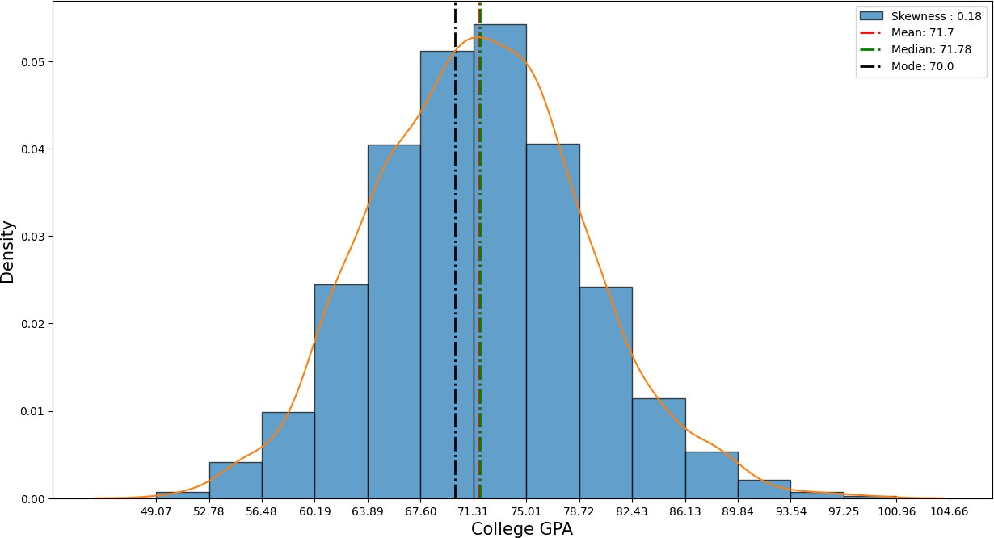
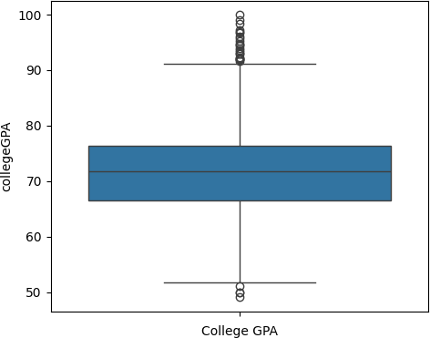

Slide 41
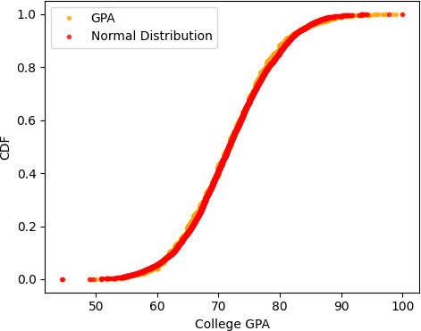
Conclusions
Inferences
Summary Plot
Histogram
75% of students had a GPA of approximately 80% or lower.
The majority of students had GPAs ranging between 63% and 78%. The highest frequency of students scored 70%, and the average GPA was 74%.
The box plot reveals the presence of both low and high extreme values within the dataset. The data is deemed to be sufficiently normally distributed.
Box Plot
CDF
Observations
1.6 English
[ ]:
# Summary Plot
plt.figure(figsize=(5,4)) df1['English'].describe()[1:].plot(alpha = 0.8,
marker = 'D', markersize = 8) plt.title('Summary Statistics for English')

Slide 42
plt.xlabel('Statistical Measures') plt.tight_layout()
plt.show()
# Histogram
bins = np.arange(df1['English'].min(), df1['English'].max()+df1['English'].
↪std(),
df1['English'].std()/2) plt.figure(figsize = (15,8)) plt.hist(df1['English'], ec = 'k',
bins = bins,
label = f"Skewness : {round(df1['English'].skew(),2)}", alpha = 0.7,
density = True) plt.xticks(bins)
plt.xlabel('English Scores', size = 15) plt.ylabel('Density', size = 15)
plt.axvline(df1['English'].mean(), label = f"Mean: {round(df1['English'].
↪mean(),2)}"
, linestyle = '-.',
color = 'red', linewidth = 2)
plt.axvline(df1['English'].median(), label = f"Median: {round(df1['English'].
↪median(),2)}"
, linestyle = '-.',
color = 'green', linewidth = 2) plt.axvline(df1['English'].mode()[0], label = f"Mode: {round(df1['English'].
↪mode()[0],2)}"
, linestyle = '-.',
color = 'k', linewidth = 2) sns.kdeplot(df1['English']) plt.legend()
plt.show()
# Box Plot
plt.figure(figsize=(5,4)) sns.boxplot(df1['English']) plt.xlabel('English Score') plt.tight_layout() plt.show()
# CDF
plt.figure(figsize=(5,4))
x_eng, y_eng = cdf(df1['English'])

Slide 43
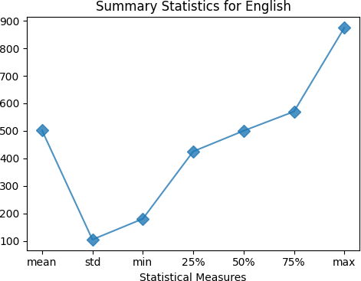
x_sample_eng , y_sample_eng = \ cdf(np.random.normal(df1['English'].mean(), df1['English'].std(), size =␣
↪len(df1['English'])))
plt.plot(x_eng, y_eng, linestyle = 'None', marker = '.', color = 'orange', alpha = 0.7, label = 'English ')
plt.plot(x_sample_eng, y_sample_eng, linestyle = 'None', marker ='.', color = 'red',
alpha = 0.7, label = 'Normal Distribution') plt.xlabel('English Scores')
plt.ylabel('CDF') plt.legend() plt.tight_layout() plt.show()

Slide 44
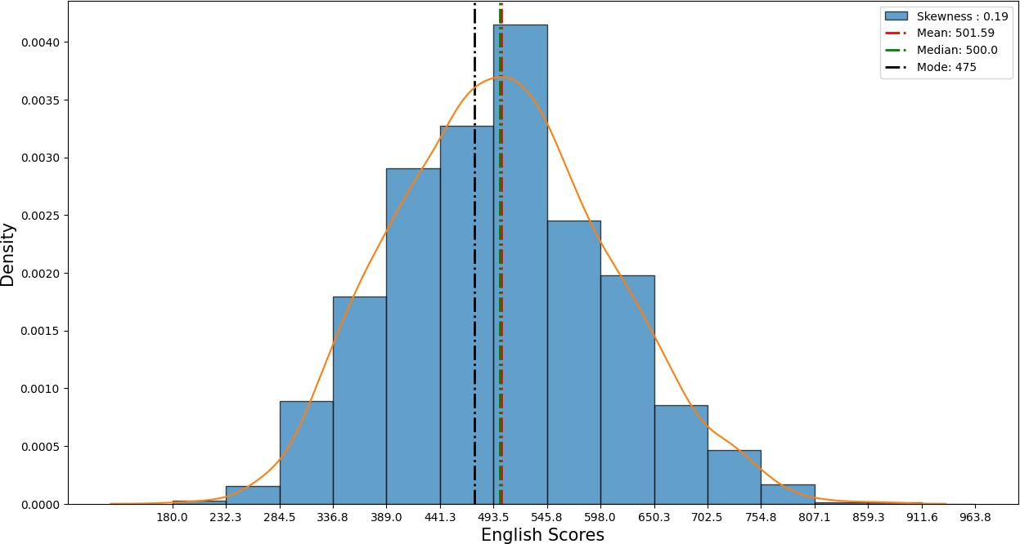
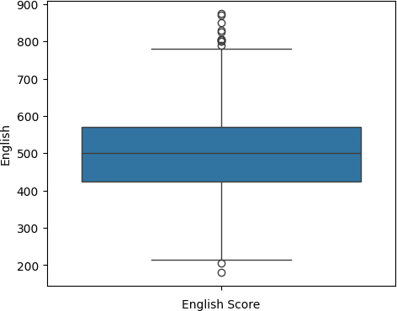

Slide 45
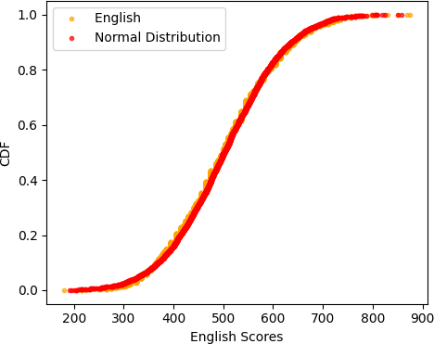
Conclusions
Paraphrased Version
Summary Plot Histogram
Box Plot CDF
Half of the students scored below 500 in their English exams.
The bulk of the scores fell within the range of 389 to 545. The peak occurred at 475, with an average score of 502.
Both lower and higher extreme values are evident from the distribution representation.
The data follows a reasonably normal distribution pattern.
Observations
1.7 Logical
[ ]:
# Summary Plot
plt.figure(figsize=(5,4)) df1['Logical'].describe()[1:].plot(alpha = 0.8,
marker = 'D', markersize = 8) plt.title('Summary Statistics for Logical Section') plt.xlabel('Statistical Measures')
plt.tight_layout() plt.show()

Slide 46
# Histogram
bins = np.arange(df1['Logical'].min(), df1['Logical'].max()+df1['Logical'].
↪std(),
df1['Logical'].std()/2) plt.figure(figsize = (15,8)) plt.hist(df1['Logical'], ec = 'k',
bins = bins,
label = f"Skewness : {round(df1['Logical'].skew(),2)}", alpha = 0.7,
density = True) plt.xticks(bins)
plt.xlabel('Logical Scores', size = 15) plt.ylabel('Density', size = 15)
plt.axvline(df1['Logical'].mean(), label = f"Mean: {round(df1['Logical'].
↪mean(),2)}"
, linestyle = '-.',
color = 'red', linewidth = 2)
plt.axvline(df1['Logical'].median(), label = f"Median: {round(df1['Logical'].
↪median(),2)}"
, linestyle = '-.',
color = 'green', linewidth = 2) plt.axvline(df1['Logical'].mode()[0], label = f"Mode: {round(df1['Logical'].
↪mode()[0],2)}"
, linestyle = '-.',
color = 'k', linewidth = 2) sns.kdeplot(df1['Logical']) plt.legend()
plt.show()
# Box Plot
plt.figure(figsize=(5,4)) sns.boxplot(df1['Logical']) plt.xlabel('Logical Score') plt.tight_layout() plt.show()
# CDF
plt.figure(figsize=(5,4))
x_log, y_log = cdf(df1['Logical']) x_sample_log , y_sample_log = \
cdf(np.random.normal(df1['Logical'].mean(), df1['Logical'].std(), size =␣
↪len(df1['Logical'])))
plt.plot(x_log, y_log, linestyle = 'None',

Slide 47
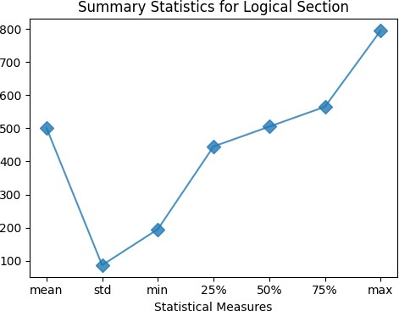
marker = '.', color = 'orange', alpha = 0.7, label = 'Logical ')
plt.plot(x_sample_log, y_sample_log, linestyle = 'None', marker ='.', color = 'red',
alpha = 0.7, label = 'Normal Distribution') plt.xlabel('Logical Scores')
plt.ylabel('CDF') plt.legend() plt.tight_layout() plt.show()

Slide 48
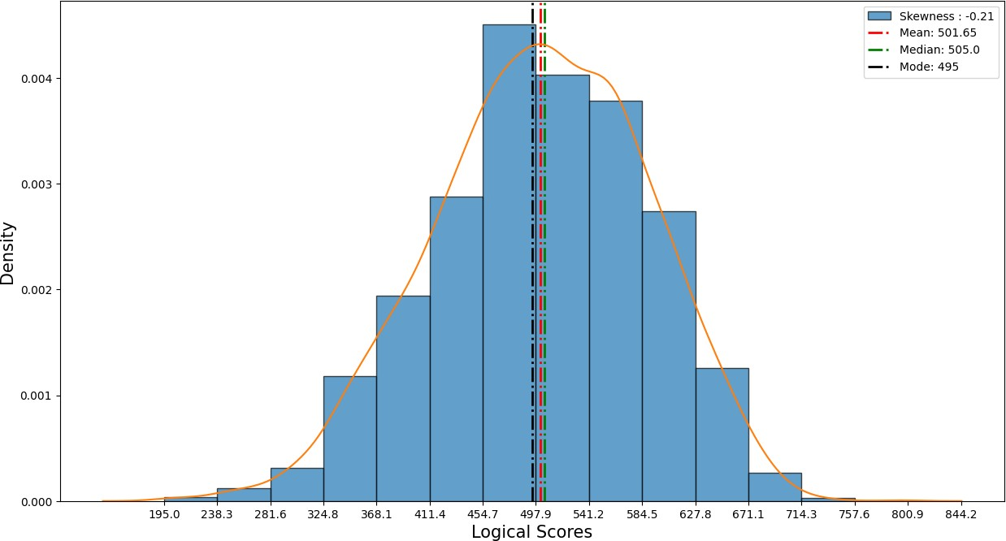
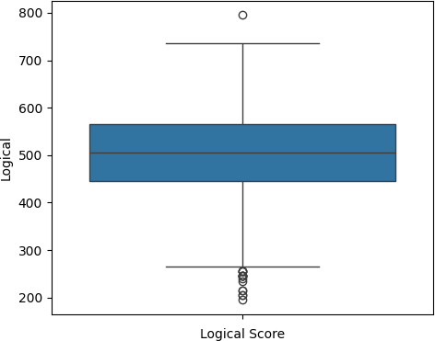

Slide 49
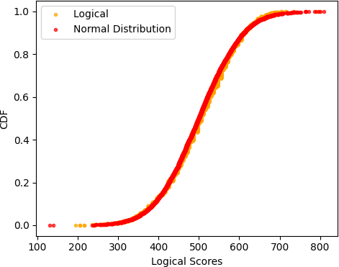
Conclusions
Inferences
Summary Plot
Histogram Box Plot CDF
Half of the students scored below 500 in the logical exams.
Most scores fell within the range of 454 to 584, peaking at 495, with an average of 502. Presence of lower extreme values, with only one high extreme value being notable.
Data closely approximates a normal distribution pattern.
Observations
1.8 Quant
[ ]:
# Summary Plot
plt.figure(figsize=(5,4)) df1['Quant'].describe()[1:].plot(alpha = 0.8,
marker = 'D', markersize = 8) plt.title('Summary Statistics for Quant Section') plt.xlabel('Statistical Measures')
plt.tight_layout()

Slide 50
plt.show()
# Histogram
bins = np.arange(df1['Quant'].min(), df1['Quant'].max()+df1['Quant'].std(), df1['Quant'].std()/2)
plt.figure(figsize = (15,8)) plt.hist(df1['Quant'], ec = 'k',
bins = bins,
label = f"Skewness : {round(df1['Quant'].skew(),2)}", alpha = 0.7,
density = True) plt.xticks(bins)
plt.xlabel('Quant Scores', size = 15) plt.ylabel('Density', size = 15)
plt.axvline(df1['Quant'].mean(), label = f"Mean: {round(df1['Quant'].mean(),2)}"
, linestyle = '-.',
color = 'red', linewidth = 2) plt.axvline(df1['Quant'].median(), label = f"Median: {round(df1['Quant'].
↪median(),2)}"
, linestyle = '-.',
color = 'green', linewidth = 2) plt.axvline(df1['Quant'].mode()[0], label = f"Mode: {round(df1['Quant'].
↪mode()[0],2)}"
, linestyle = '-.',
color = 'k', linewidth = 2) sns.kdeplot(df1['Logical']) plt.legend()
plt.show()
# Box Plot
plt.figure(figsize=(5,4)) sns.boxplot(df1['Quant']) plt.xlabel('Quant Score') plt.tight_layout() plt.show()
# CDF
plt.figure(figsize=(5,4)) x_q, y_q = cdf(df1['Quant']) x_sample_q , y_sample_q = \
cdf(np.random.normal(df1['Quant'].mean(), df1['Quant'].std(), size =␣
↪len(df1['Quant'])))
plt.plot(x_q, y_q, linestyle = 'None',

Slide 51
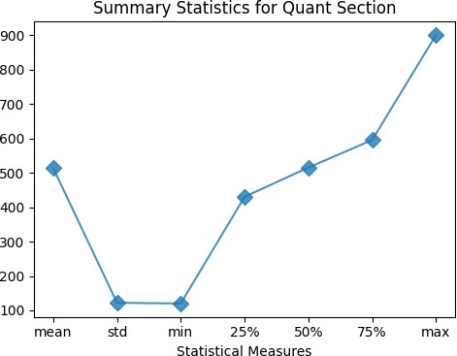
marker = '.', color = 'orange', alpha = 0.7, label = 'Quant ')
plt.plot(x_sample_q, y_sample_q, linestyle = 'None', marker ='.', color = 'red',
alpha = 0.7, label = 'Normal Distribution') plt.xlabel('Quant Scores')
plt.ylabel('CDF') plt.legend() plt.tight_layout() plt.show()

Slide 52
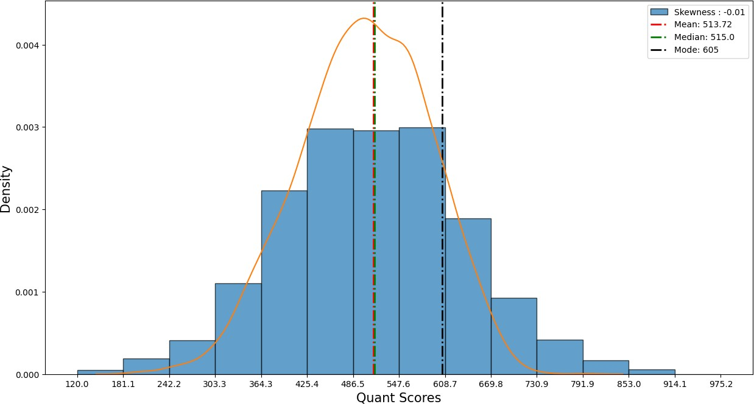


Slide 53
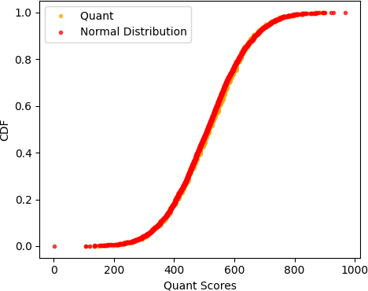
Conclusions
Inferences
Summary Plot Histogram
Box Plot CDF
75% of students’ logical score was less than 600.
Majority of the scores were in between 425-608. The maximum number of students scored 605 with an average of 513.
The box plot shows the presence of both low and high extreme values. The data is sufficiently close to normally distributed.
Observations
1.9 Computer Programming
[ ]:
# Summary Plot
plt.figure(figsize=(5,4)) df1['ComputerProgramming'].describe()[1:].plot(alpha = 0.8,
marker = 'D', markersize = 8) plt.title('Summary Statistics for computer progamming') plt.xlabel('Statistical Measures')
plt.tight_layout() plt.show()
# Histogram

Slide 54
bins = np.arange(df1['ComputerProgramming'].min(), df1['ComputerProgramming'].
↪max()+df1['ComputerProgramming'].std(),
df1['ComputerProgramming'].std()/2) plt.figure(figsize = (15,6)) plt.hist(df1['ComputerProgramming'], ec = 'k',
bins = bins,
label = f"Skewness : {round(df1['ComputerProgramming'].skew(),2)}", alpha = 0.7,
density = True) plt.xticks(bins)
plt.xlabel('Computer Programming Scores', size = 15) plt.ylabel('Density', size = 15)
plt.axvline(df1['ComputerProgramming'].mean(), label = f"Mean:␣
↪{round(df1['ComputerProgramming'].mean(),2)}"
, linestyle = '-.',
color = 'red', linewidth = 2) plt.axvline(df1['ComputerProgramming'].median(), label = f"Median:␣
↪{round(df1['ComputerProgramming'].median(),2)}"
, linestyle = '-.',
color = 'green', linewidth = 2) plt.axvline(df1['ComputerProgramming'].mode()[0], label = f"Mode:␣
↪{round(df1['ComputerProgramming'].mode()[0],2)}"
, linestyle = '-.',
color = 'k', linewidth = 2) sns.kdeplot(df1['ComputerProgramming']) plt.legend()
plt.show()
# Box Plot
plt.figure(figsize=(5,4)) sns.boxplot(df1['ComputerProgramming']) plt.xlabel('Computer Programming Score') plt.tight_layout()
plt.show()
# CDF
plt.figure(figsize=(5,4))
x_cp, y_cp = cdf(df1['ComputerProgramming']) x_sample_cp , y_sample_cp = \
cdf(np.random.normal(df1['ComputerProgramming'].mean(),␣
↪df1['ComputerProgramming'].std(), size = \
len(df1['ComputerProgramming']))) plt.plot(x_cp, y_cp, linestyle = 'None',

Slide 55
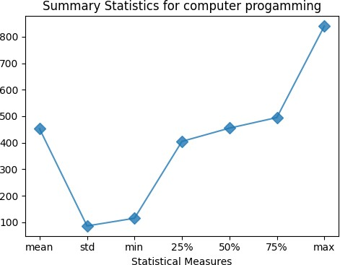
marker = '.', color = 'orange',
alpha = 0.7, label = 'Computer Programming ') plt.plot(x_sample_cp, y_sample_cp, linestyle = 'None',
marker ='.', color = 'red',
alpha = 0.7, label = 'Normal Distribution') plt.xlabel('Computer Programming Scores') plt.ylabel('CDF')
plt.legend() plt.tight_layout() plt.show()

Slide 56
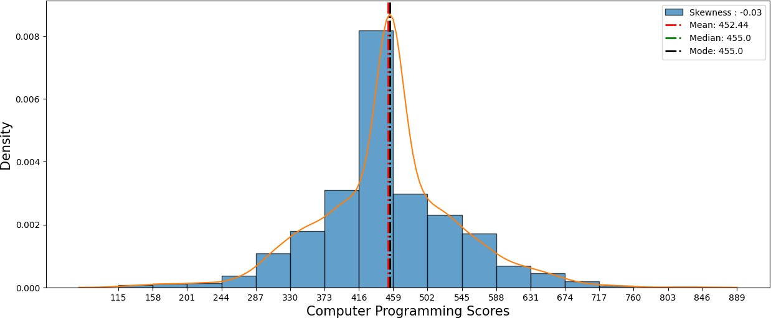
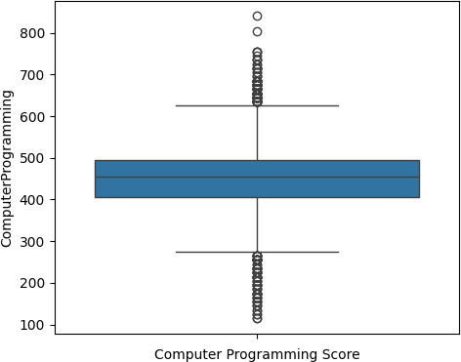

Slide 57
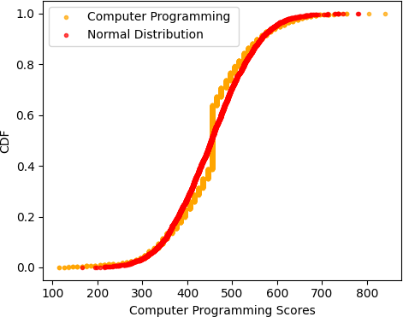
Conclusions
Inferences Version
Summary Plot Histogram
Box Plot CDF
50% of students’ scores were below 500.
The majority of scores ranged between 416 and 459. The peak occurred at 455, with an average score of 452.
The box plot illustrates the presence of numerous low extreme values as well as high extreme values.
The data does not follow a normal distribution pattern.
Observations
1.10 Electronics & Semiconductors
[ ]:
# Summary Plot
plt.figure(figsize=(5,4)) df1['ElectronicsAndSemicon'].describe()[1:].plot(alpha = 0.8,
marker = 'D', markersize = 8) plt.title('Summary Statistics for Electronics & Semiconductors') plt.xlabel('Statistical Measures')
plt.tight_layout() plt.show()

Slide 58
# Histogram
bins = np.arange(df1['ElectronicsAndSemicon'].min(),␣
↪df1['ElectronicsAndSemicon'].max()+df1['ElectronicsAndSemicon'].std(),
df1['ElectronicsAndSemicon'].std()/2) plt.figure(figsize = (15,6)) plt.hist(df1['ElectronicsAndSemicon'], ec = 'k',
bins = bins,
label = f"Skewness : {round(df1['ElectronicsAndSemicon'].skew(),2)}", alpha = 0.7,
density = True) plt.xticks(bins)
plt.xlabel('Electronics & Semiconductors Scores', size = 15) plt.ylabel('Density', size = 15)
plt.axvline(df1['ElectronicsAndSemicon'].mean(), label = f"Mean:␣
↪{round(df1['ElectronicsAndSemicon'].mean(),2)}"
, linestyle = '-.',
color = 'red', linewidth = 2) plt.axvline(df1['ElectronicsAndSemicon'].median(), label = f"Median:␣
↪{round(df1['ElectronicsAndSemicon'].median(),2)}"
, linestyle = '-.',
color = 'green', linewidth = 2) plt.axvline(df1['ElectronicsAndSemicon'].mode()[0], label = f"Mode:␣
↪{round(df1['ElectronicsAndSemicon'].mode()[0],2)}"
, linestyle = '-.',
color = 'k', linewidth = 2) sns.kdeplot(df1['ElectronicsAndSemicon']) plt.legend()
plt.show()
# Box Plot
plt.figure(figsize=(5,4)) sns.boxplot(df1['ElectronicsAndSemicon']) plt.xlabel('Electronics & Semiconductors Score') plt.tight_layout()
plt.show()
# CDF
plt.figure(figsize=(5,4))
x_cp, y_cp = cdf(df1['ElectronicsAndSemicon']) x_sample_cp , y_sample_cp = \
cdf(np.random.normal(df1['ElectronicsAndSemicon'].mean(),␣
↪df1['ElectronicsAndSemicon'].std(), size = \
len(df1['ElectronicsAndSemicon'])))

Slide 59
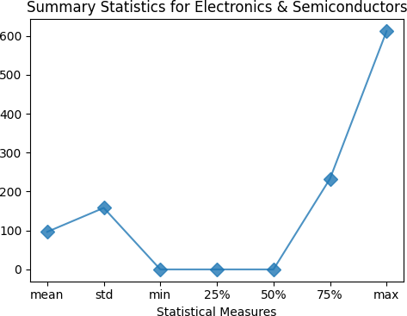
plt.plot(x_cp, y_cp, linestyle = 'None', marker = '.', color = 'orange',
alpha = 0.7, label = 'Electronics & Semiconductors') plt.plot(x_sample_cp, y_sample_cp, linestyle = 'None',
marker ='.', color = 'red',
alpha = 0.7, label = 'Normal Distribution') plt.xlabel('Electronics & Semiconductors Scores') plt.ylabel('CDF')
plt.legend() plt.tight_layout() plt.show()

Slide 60



Slide 61

Conclusions
Inferences
Summary Plot Histogram
Box Plot CDF
About 75% of students scored less than 250.
Most scores fell between 0 and 79. The highest number of students scored 0, with an average score of 96.
The lowest score is equal to the median of the dataset.
The data does not conform to a normal distribution pattern.
Observations
1.11 Age
[ ]:
# Summary Plot
plt.figure(figsize=(5,4)) df1['Age'].describe()[1:].plot(alpha = 0.8,
marker = 'D', markersize = 8) plt.title('Summary Statistics for Age') plt.xlabel('Statistical Measures')
plt.tight_layout() plt.show()
# Histogram

Slide 62
bins = np.arange(df1['Age'].min(), df1['Age'].max()+df1['Age'].std(), df1['Age'].std()/2)
plt.figure(figsize = (15,8)) plt.hist(df1['Age'], ec = 'k',
bins = bins,
label = f"Skewness : {round(df1['Age'].skew(),2)}", alpha = 0.7,
density = True) plt.xticks(bins) plt.xlabel('Age', size = 15) plt.ylabel('Density', size = 15)
plt.axvline(df1['Age'].mean(), label = f"Mean: {round(df1['Age'].mean(),2)}"
, linestyle = '-.',
color = 'red', linewidth = 2) plt.axvline(df1['Age'].median(), label = f"Median: {round(df1['Age'].
↪median(),2)}"
, linestyle = '-.',
color = 'green', linewidth = 2) plt.axvline(df1['Age'].mode()[0], label = f"Mode: {round(df1['Age'].
↪mode()[0],2)}"
, linestyle = '-.',
color = 'k', linewidth = 2) sns.kdeplot(df1['Age'])
plt.legend() plt.show()
# Box Plot
plt.figure(figsize=(5,4)) sns.boxplot(df1['Age']) plt.xlabel('Age') plt.tight_layout() plt.show()
# CDF
plt.figure(figsize=(5,4)) x_cp, y_cp = cdf(df1['Age']) x_sample_cp , y_sample_cp = \
cdf(np.random.normal(df1['Age'].mean(), df1['Age'].std(), size = \
len(df1['Age']))) plt.plot(x_cp, y_cp, linestyle = 'None',
marker = '.', color = 'orange', alpha = 0.7, label = 'Age')
plt.plot(x_sample_cp, y_sample_cp, linestyle = 'None',

Slide 63

marker ='.', color = 'red',
alpha = 0.7, label = 'Normal Distribution') plt.xlabel('Age')
plt.ylabel('CDF') plt.legend() plt.tight_layout() plt.show()

Slide 64



Slide 65

Conclusions
Inferences
Summary Plot Histogram
Box Plot CDF
Approximately 75% of students are under 26 years old.
The majority of students’ ages ranged between 22 and 25. The mean, median, and mode ages are approximately 25.
The box plot indicates the presence of 4 students with very high ages and one with a very low age compared to other data points.
The age data does not follow a normal distribution pattern.
Observations
1.3.2 2. Categorical Features
2.1 Designation
[ ]:
df1['Designation'].value_counts()[1:].sort_values(
ascending=True
).plot(
kind='barh', title='Designation Counts', figsize=(7, 3),
ec='k'
)

Slide 66
plt.ylabel('Designation') plt.xlabel('Count') plt.tight_layout() plt.show()
Observations Software engineer is the most common desgination of all, followed by system engineer and software developer.
NOTE : This graph contains the most common designations. There exists OTHER
category too.
2.2 JobCity
[ ]:
df1['JobCity'].value_counts().sort_values(ascending=True).plot(
kind='barh', cmap='summer', title='City Counts', figsize=(6,3), ec='k'
)
plt.ylabel('City') plt.xlabel('Count') plt.tight_layout() plt.show()

Slide 67
Observations The most favourable city for job placements is bangalore, followed by Noid, Hy- derabad and pune. Mumbai and kolkata being least favourable.
2.3 Gender
[ ]:
plt.figure(figsize=(3,3))
plt.pie(df1['Gender'].value_counts().tolist(), labels=df1['Gender'].value_counts().index, autopct='%1.1f%%',
radius=1.5, wedgeprops={'edgecolor': 'k'},
textprops={'fontsize': 10, 'fontweight': 'bold'}, shadow=True,
startangle=90, pctdistance=0.85)
plt.pie(df1['Gender'].value_counts().tolist(), colors=['white'], wedgeprops={'edgecolor': 'white'}, radius=1)
plt.title('Gender %', pad=40, size=20) plt.tight_layout()
plt.show()

Slide 68

Observations The dataset is not balanced in terms of gender as the population of Male is really larger as compared to the female one.
2.4 10board & 12board
[ ]:
fig, ax = plt.subplots(2, 1, figsize=(8, 6), sharex=True)
df1['10board'].str.upper().value_counts().sort_values(ascending=True).plot( kind='barh',
ax=ax[0],
ec='k',
title='10th Boards'
)
ax[0].set_ylabel('Board', size=15)
df1['12board'].str.upper().value_counts().sort_values(ascending=True).plot( kind='barh',
ax=ax[1],
ec='k',
title='12th Boards'
)
ax[1].set_ylabel('Board', size=15) ax[1].set_xlabel('Count', size=15)
plt.tight_layout() plt.show()

Slide 69

Observations CBSE is the most common school board for both 12th and 10th.
2.5 CollegeTier
[ ]:
plt.figure(figsize=(3,3))
plt.pie(df1['CollegeTier'].value_counts().tolist(), labels = df1['CollegeTier'].
↪value_counts().index,
autopct = '%1.1f%%', radius = 1.75,
wedgeprops = {'edgecolor':'k'},
textprops = {'fontsize':9,'fontweight':'bold'}, shadow = True,
startangle = 90,
pctdistance = 0.85) plt.pie(df1['CollegeTier'].value_counts().tolist(), colors = ['white'],
wedgeprops = {'edgecolor':'white'}, radius = 1)
plt.title('College Tier %',pad = 40, size = 12) plt.margins(0.02)
plt.tight_layout() plt.show()

Slide 70

Observations Almost all the college belongs to Tier 1 only with a percentage of 92.5
2.6 Degree
[ ]:
df1['Degree'].value_counts().sort_values(ascending=True).plot(
kind='barh', title='Degree', figsize=(5, 3), ec='k', alpha=0.7
)
plt.ylabel('Degree') plt.xlabel('Count') plt.xscale('log') plt.tight_layout() plt.show()

Slide 71
Observations Most of the students have done their graduation in B.Tech and there are very less students from M.Sc(Tech)
2.7 CollegeCityTier
[ ]:
plt.figure(figsize=(3,3))
plt.pie(df1['CollegeCityTier'].value_counts().tolist(), labels =␣
↪df1['CollegeCityTier'].value_counts().index,
autopct = '%1.1f%%', radius = 1.5,
wedgeprops = {'edgecolor':'k'},
textprops = {'fontsize':8,'fontweight':'bold'}, shadow = True,
startangle = 90,
pctdistance = 0.84) plt.pie(df1['CollegeCityTier'].value_counts().tolist(), colors = ['white'],
wedgeprops = {'edgecolor':'white'}, radius = 1)
plt.title('College Tier %',pad = 30, size = 12) plt.margins(0.02)
plt.tight_layout() plt.show()

Slide 72

Observations Majority of the colleges are form Tier 0 city.
2.8 GraduationYear
[ ]:
df1['GraduationYear'].value_counts().sort_values(ascending=True).plot(
kind='barh', title='Graduation Year', figsize=(6, 3),
ec='k', alpha=0.7
)
plt.ylabel('Year') plt.xlabel('Count') plt.tight_layout() plt.show()

Slide 73
Observations Maximum number of students were graduated in 2013, followed by the year 2014 and 2012.
1.3.3 Removing Outliers
[ ]:
def outlier_treatment(datacolumn):
sorted(datacolumn)
Q1,Q3 = np.percentile(datacolumn , [25,75])
IQR = Q3 - Q1
lower_range = Q1 - (1.5 * IQR) upper_range = Q3 + (1.5 * IQR) return lower_range,upper_range
[ ]:
df1.columns
[ ]: Index(['Salary', 'DOJ', 'DOL', 'Designation', 'JobCity', 'Gender', 'DOB', '10percentage', '10board', '12graduation', '12percentage', '12board', 'CollegeTier', 'Degree', 'Specialization', 'collegeGPA', 'CollegeCityTier', 'CollegeState', 'GraduationYear', 'English', 'Logical', 'Quant', 'Domain', 'ComputerProgramming', 'ElectronicsAndSemicon', 'ComputerScience', 'conscientiousness', 'agreeableness', 'extraversion', 'nueroticism', 'openess_to_experience', 'Age', 'Tenure'],
dtype='object')
[ ]:
columns = ['Salary','10percentage','12percentage','English',
'Logical','Quant','Domain', 'ComputerProgramming', 'ElectronicsAndSemicon', 'ComputerScience', 'conscientiousness',

Slide 74
'agreeableness', 'extraversion', 'nueroticism', 'openess_to_experience', 'Age', 'Tenure']
df2 = df1.copy()
[ ]:
for cols in columns:
lowerbound, upperbound = outlier_treatment(df2[cols])
df2 = df2.drop(df2[(df2[cols] < lowerbound) | (df2[cols] > upperbound)].
↪index)
[ ]:
print(f'Number of observation with outliers: {df1.shape[0]}')
print(f'Number of observations without outliers: {df2.shape[0]}')
Number of observation with outliers: 3864 Number of observations without outliers: 2490
  Bivariate Analysis
    1. Barplots
1.1 Average Salary for each Designation
[ ]: fig, ax = plt.subplots(2, 1, figsize = (8,6), sharex = True) sns.barplot(x = 'Salary', y = 'Designation',
data = df1, palette = 'BuGn', capsize = 0.1,
ax = ax[0]) ax[0].axvline(df1['Salary'].mean(), color = 'k',
linestyle = ':',
linewidth = 2, label = 'Overall\nAvg. Salary') ax[0].set_title('Avg Salary for Each Designation(with Outliers)') ax[0].legend()
ax[0].set_xlabel('')
sns.barplot(x = 'Salary', y = 'Designation', data = df2,
palette = 'BuGn', capsize = 0.1,
ax = ax[1]) ax[1].axvline(df2['Salary'].mean(), color = 'k',
linestyle = ':',
linewidth = 2, label = 'Overall\nAvg. Salary') ax[1].set_title('Avg Salary for Each Designation(without Outliers)') ax[1].legend()
ax[1].set_xlabel('Salary')
plt.tight_layout()

Slide 75
plt.show()
<ipython-input-69-a02ae9c7fbad>:2: FutureWarning:
Passing `palette` without assigning `hue` is deprecated and will be removed in v0.14.0. Assign the `y` variable to `hue` and set `legend=False` for the same effect.
sns.barplot(x = 'Salary', y = 'Designation',
<ipython-input-69-a02ae9c7fbad>:15: FutureWarning:
Passing `palette` without assigning `hue` is deprecated and will be removed in v0.14.0. Assign the `y` variable to `hue` and set `legend=False` for the same effect.
sns.barplot(x = 'Salary', y = 'Designation',
Observations Bar plot shows the maximum salary for each Designation. Senior Software En- gineer has the highest salary but they also has the maximum standard deviation in their salary. There are only two designations namely, software developer and technical support engineer who has salary lower than average salary.

Slide 76
[ ]:
1.2 Average Salary for each Gender
fig, ax = plt.subplots(2, 1, figsize = (8,4), sharex = True)
sns.barplot(x = 'Salary', y = 'Gender', data = df1,
palette = 'BuGn', capsize = 0.1,
ax = ax[0]) ax[0].axvline(df1['Salary'].mean(), color = 'k',
linestyle = ':',
linewidth = 2, label = 'Overall\nAvg. Salary') ax[0].set_title('Avg Salary per Gender(with Outliers)') ax[0].legend()
ax[0].set_xlabel('')
sns.barplot(x = 'Salary', y = 'Gender', data = df2,
palette = 'RdPu', capsize = 0.1,
ax = ax[1]) ax[1].axvline(df2['Salary'].mean(), color = 'k',
linestyle = ':',
linewidth = 2, label = 'Overall\nAvg. Salary') ax[1].set_title('AvgSalary per Gender(without Outliers)') ax[1].legend()
ax[1].set_xlabel('Salary')
plt.tight_layout() plt.show()
<ipython-input-70-46f5bd1b91dc>:2: FutureWarning:
Passing `palette` without assigning `hue` is deprecated and will be removed in v0.14.0. Assign the `y` variable to `hue` and set `legend=False` for the same effect.
sns.barplot(x = 'Salary', y = 'Gender',
<ipython-input-70-46f5bd1b91dc>:15: FutureWarning:
Passing `palette` without assigning `hue` is deprecated and will be removed in v0.14.0. Assign the `y` variable to `hue` and set `legend=False` for the same effect.
sns.barplot(x = 'Salary', y = 'Gender',

Slide 77
Observations The average salary for both male and female is approximately equal and it implies that there was no gender bias in terms of salary. It is also plausible to say that Female’s get salary below the overall average salary.
1.4.2 2. Scatter Plots
2.1 Salary & 10th score
[ ]:
fig, ax = plt.subplots(1, 2, figsize = (6,4), sharex = True, sharey = True)
ax[0].scatter(df1['Salary'],df1['10percentage'],
ec = 'k',
color = 'skyblue', alpha = 0.7,
s = 40,
label = f"Correlation: {round(df1[['Salary','10percentage']].
↪corr().iloc[1,0],2)}"
)
ax[0].set_ylabel('10percentage') ax[0].set_title('With Outliers', size=10) ax[0].legend()
ax[1].scatter(df2['Salary'],df2['10percentage'],
ec = 'k',
color = 'green', alpha = 0.5,
s = 40,

Slide 78
label = f"Correlation: {round(df2[['Salary','10percentage']].
↪corr().iloc[1,0],2)}"
)
ax[1].set_title('Without Outliers', size=10) ax[1].legend()
fig.suptitle('Correlation b/w Salary & 10th Score', size = 10) plt.show()
Observations There does not exist any correlation between Salary and 10th scores.
2.2 Salary & 12th score
[ ]:
fig, ax = plt.subplots(1, 2, figsize = (6,4), sharex = True, sharey = True)
ax[0].scatter(df1['Salary'],df1['12percentage'],
ec = 'k', color = 'red', alpha = 0.7,
s = 50,

Slide 79

label = f"Correlation: {round(df1[['Salary','12percentage']].
↪corr().iloc[1,0],2)}"
)
ax[0].set_ylabel('12percentage') ax[0].set_title('With Outliers', size=10) ax[0].legend()
ax[1].scatter(df2['Salary'],df2['12percentage'],
ec = 'k',
color = 'brown', alpha = 0.5,
s = 50,
label = f"Correlation: {round(df2[['Salary','12percentage']].
↪corr().iloc[1,0],2)}"
)
ax[1].set_title('Without Outliers', size=10) ax[1].legend()
fig.suptitle('Correlation b/w Salary & 10th Score', size = 10) plt.show()

Slide 80
Observations There does not exist any correlation between Salary and 10th scores.
2.3 Salary & CollegeGPA score
[ ]:
fig, ax = plt.subplots(1, 2, figsize = (6,4), sharex = True, sharey = True)
ax[0].scatter(df1['Salary'],df1['collegeGPA'],
ec = 'k',
color = 'cyan', alpha = 0.7,
s = 50,
label = f"Correlation: {round(df1[['Salary','collegeGPA']].
↪corr().iloc[1,0],2)}"
)
ax[0].set_ylabel('GPA') ax[0].set_title('With Outliers', size=10) ax[0].legend()
ax[1].scatter(df2['Salary'],df2['collegeGPA'],
ec = 'k',
color = 'slateblue', alpha = 0.5,
s = 50,
label = f"Correlation: {round(df2[['Salary','collegeGPA']].
↪corr().iloc[1,0],2)}"
)
ax[1].set_title('Without Outliers', size=10) ax[1].legend()
fig.suptitle('Correlation b/w Salary & 10th Score', size = 10) plt.show()

Slide 81

Observations There does not exist any correlation between Salary and 10th scores.
2.4 Salary & Age
[ ]:
fig, ax = plt.subplots(2, 1, figsize = (6,8), sharex = True)
ax[0].scatter(df1['Age'], df1['Salary'],
ec = 'k',
color = '#ff9911', alpha = 0.6,
label = f"Correlation : {round(df1[['Age','Salary']].corr().
↪iloc[1,0],2)}"
)
ax[0].legend() ax[0].set_ylabel('Salary')
ax[0].set_title('With Outliers' , size=10)
ax[1].scatter(df2['Age'], df2['Salary'],
ec = 'k',
color = '#834567',
alpha = 0.6,

Slide 82
label = f"Correlation : {round(df2[['Age','Salary']].corr().
↪iloc[1,0],2)}"
)
ax[1].legend() ax[1].set_ylabel('Salary')
ax[1].set_title('Without Outliers' , size=10) ax[1].set_xlabel('Age')
fig.suptitle('Correaltion b/w Salary and Age', size = 10) plt.show()

Slide 83
Observations After removing the outliers, it is evident that the salary and age are not related to each other.

Slide 84
[ ]:
2.5 Salary & Tenure
fig, ax = plt.subplots(2, 1, figsize = (6,6), sharex = True)
ax[0].scatter(df1['Tenure'], df1['Salary'],
ec = 'k',
color = '#ff9911', alpha = 0.6,
label = f"Correlation : {round(df1[['Tenure','Salary']].corr().
↪iloc[1,0],2)}"
)
ax[0].legend() ax[0].set_ylabel('Salary')
ax[0].set_title('With Outliers' , size=10)
ax[1].scatter(df2['Tenure'], df2['Salary'],
ec = 'k',
color = '#834567',
alpha = 0.6,
label = f"Correlation : {round(df2[['Tenure','Salary']].corr().
↪iloc[1,0],2)}"
)
ax[1].legend() ax[1].set_ylabel('Salary')
ax[1].set_title('Without Outliers' , size=10) ax[1].set_xlabel('Tenure')
fig.suptitle('Correaltion b/w Salary and Tenure', size = 10) plt.show()

Slide 85

Observations After removing the outliers, it is evident that salary gets about 50% of increment as tenure increase as there is a positive correlation of 0.60.
2.6 Salary with English, Quants, Logical
[ ]:
fig, ax = plt.subplots(3, 2, figsize = (8,8), sharey = True)
ax[0,0].scatter(df1['English'],df1['Salary'],
ec = 'k',
color = 'orange', alpha = 0.5,
label = f"Correlation : {round(df1[['English','Salary']].corr().
↪iloc[1,0],2)}"
)

Slide 86
ax[0,0].set_ylabel('Salary') ax[0,0].set_xlabel('English Scores') ax[0,0].set_title('With Outliers') ax[0,0].legend()
ax[0,1].scatter(df2['English'],df2['Salary'],
ec = 'k',
color = 'pink', alpha = 0.5,
label = f"Correlation : {round(df2[['English','Salary']].corr().
↪iloc[1,0],2)}"
)
ax[0,1].set_title('Without Outliers') ax[0,1].set_xlabel('English Scores') ax[0,1].legend()
ax[1,0].scatter(df1['Quant'],df1['Salary'],
ec = 'k',
color = 'skyblue', alpha = 0.5,
label = f"Correlation : {round(df1[['Quant','Salary']].corr().
↪iloc[1,0],2)}"
)
ax[1,0].set_ylabel('Salary') ax[1,0].set_xlabel('Quant Scores') ax[1,0].set_title('With Outliers') ax[1,0].legend()
ax[1,1].scatter(df2['Quant'],df2['Salary'],
ec = 'k',
color = 'slateblue', alpha = 0.5,
label = f"Correlation : {round(df2[['Quant','Salary']].corr().
↪iloc[1,0],2)}"
)
ax[1,1].set_ylabel('Salary') ax[1,1].set_title('Without Outliers') ax[1,1].legend()
ax[2,0].scatter(df1['Logical'],df1['Salary'],

Slide 87
ec = 'k',
color = 'magenta', alpha = 0.5,
label = f"Correlation : {round(df1[['Logical','Salary']].corr().
↪iloc[1,0],2)}"
)
ax[2,0].set_ylabel('Salary') ax[2,0].set_xlabel('Logical Scores') ax[2,0].set_title('With Outliers') ax[2,0].legend()
ax[2,1].scatter(df2['Logical'],df2['Salary'],
ec = 'k',
color = 'brown', alpha = 0.5,
label = f"Correlation : {round(df2[['Logical','Salary']].corr().
↪iloc[1,0],2)}"
)
ax[2,1].set_ylabel('Salary') ax[2,1].set_title('Without Outliers') ax[2,1].legend()
plt.tight_layout() plt.show()

Slide 88

Observations The scatters plots above gives adequate evidence that salary is not effected by any of the above scores.
1.4.3 3. Crosstabs
3.1 Gender and Specialization
[ ]:
pd.crosstab(df1['Gender'],df1['Specialization']).T.plot(kind = 'barh',
ec = 'k', figsize = (8,4))
[ ]: <Axes: ylabel='Specialization'>

Slide 89

Observations There are almost males 2 times as of females in every specialization. Also, there are very less number of females who opted for mechanical and electronics.
1.4.4 4. Pivot Tables
4.1 Average Salary per JobCity
[ ]:
pd.pivot_table(index = 'JobCity',
values = 'Salary',
data = df2).plot(kind = 'barh',
ec = 'k', alpha = 0.6,
color = 'skyblue',
title = 'Avg. Salary per JobCity ', figsize = (8,4))
plt.xlabel('Salary')
plt.axvline(df2['Salary'].mean() - df2['Salary'].std(), color = 'red',
linestyle = ':', label = 'Mean - std')
plt.axvline(df2['Salary'].mean(), color = 'k', label = 'Mean') plt.axvline(df2['Salary'].mean() + df2['Salary'].std(), color = 'red',
linestyle = ':', label = 'Mean + std')
plt.legend() plt.show()

Slide 90

[ ]:
4.2 Average Salary per CollegeTier
pd.pivot_table(index = 'CollegeTier',
values = 'Salary',
data = df2).plot(kind = 'barh',
alpha = 0.6,
color = 'slateblue',
title = 'Avg. Salary per CollegeTier ', figsize = (8,4),
ec = 'k')
plt.xlabel('Salary')
plt.axvline(df2['Salary'].mean() - df2['Salary'].std(), color = 'red',
linestyle = ':', label = 'Mean - std')
plt.axvline(df2['Salary'].mean(), color = 'k', label = 'Mean') plt.axvline(df2['Salary'].mean() + df2['Salary'].std(), color = 'red',
linestyle = ':', label = 'Mean + std')
plt.legend() plt.show()

Slide 91

Observations College within Tier 1 offers high salary as compared to the colleges in TIer 2. Colleges in Tier 2 offers below overall average salary.
4.3 Average Salary per CollegeCityTier
[ ]:
pd.pivot_table(index = 'CollegeCityTier',
values = 'Salary',
data = df2).plot(kind = 'barh',
alpha = 0.6,
color = 'magenta',
title = 'Avg. Salary per College City Tier ', figsize = (8,4),
ec = 'k')
plt.xlabel('Salary')
plt.axvline(df2['Salary'].mean() - df2['Salary'].std(), color = 'red',
linestyle = ':', label = 'Mean - std')
plt.axvline(df2['Salary'].mean(), color = 'k', label = 'Mean') plt.axvline(df2['Salary'].mean() + df2['Salary'].std(), color = 'red',
linestyle = ':', label = 'Mean + std')
plt.legend() plt.show()

Slide 92

Obervations Cities under Tier 1 and 2 offers almost same salaries to students.
  Research Questions
    1. Times of India article dated Jan 18, 2019 states that “After doing your Computer Science Engineering if you take up jobs as a Programming Analyst, Software Engineer, Hardware Engineer and Associate Engineer you can earn up to 2.5-3 lakhs as a fresh graduate.”
Solution with Visualization
[ ]:
designations = ameo_data['Designation'].value_counts().sort_index()
pd.set_option('display.max_rows', None)
print(designations)
[ ]:
ameo_data['Designation'] = ameo_data['Designation'].replace([
'programmer analyst trainee', 'programmer analyst'
], 'programmer analyst'
)
ameo_data['Designation'] = ameo_data['Designation'].replace([
'software eng', 'software engg', 'software engineer', 'software engineere',␣
↪'software enginner'
], 'software engineer'
)

Slide 93

[ ]:
df3 = ameo_data[(ameo_data["Designation"].isin(["programmer analyst", "software␣
↪engineer", "hardware engineer", "associate engineer"])) &
(ameo_data["Specialization"].isin(["computer science &␣
↪engineering", "computer engineering"]))]
[ ]:
fig, ax = plt.subplots(figsize=(10, 4))
sns.barplot(x='Salary', y='Designation', data=df3,
capsize=0.1, width=0.3, ax=ax)
ax.axvline(df3['Salary'].mean(), color='k', linestyle=':',
linewidth=2, label='Overall\nAvg. Salary')
ax.set_title('Avg Salary for Each Designation after pursuing Computer Science␣
↪Engineering')
ax.legend(loc='upper right', bbox_to_anchor=(1.4, 1)) ax.set_xlabel('') ax.set_xticklabels(ax.get_xticklabels(), rotation=90)
plt.tight_layout() plt.show()
<ipython-input-87-1b3bff5aee31>:13: UserWarning: FixedFormatter should only be used together with FixedLocator
ax.set_xticklabels(ax.get_xticklabels(), rotation=90)
Solution considering all designations at once in Hypothesis

Slide 94
[ ]:
import random
n = 40
salary_random = random.sample(df3['Salary'].tolist(),n) print(salary_random)
[490000, 325000, 310000, 300000, 390000, 325000, 220000, 145000, 375000, 325000,
300000, 330000, 335000, 200000, 335000, 500000, 320000, 300000, 400000, 450000,
340000, 305000, 350000, 600000, 350000, 440000, 275000, 345000, 310000, 340000,
305000, 345000, 325000, 350000, 275000, 340000, 230000, 355000, 315000, 120000]
Function for T-Score
[ ]:
def t_score(sample_size, sample_mean, pop_mean, sample_std):
numerator = sample_mean - pop_mean denomenator = sample_std / sample_size**0.5 return numerator / denomenator
[ ]:
Calculating sample values
from scipy.stats import t,norm
import statistics
print('Sample Mean: ', statistics.mean(salary_random))
print('Sample Standard Deviation: ', statistics.stdev(salary_random))
Sample Mean: 332250
Sample Standard Deviation: 87030.4249776759
[ ]:
sample_size = 40
sample_mean = statistics.mean(salary_random) pop_mean = 275000
sample_std = statistics.stdev(salary_random)
[ ]:
Calculating t_value
t_value = t_score(sample_size, sample_mean, pop_mean, sample_std)
print(t_value)
4.160393243881741
Calculating t_critical
[ ]:
confidence_level = 0.95
alpha = 1 - confidence_level
t_critical = t.ppf(1 - alpha/2, df = 99) print(t_critical)

Slide 95
1.9842169515086827
One Sample t-test Visualization
[ ]:
x_min = -200000
x_max = 800000
mean = pop_mean std = sample_std
x = np.linspace(x_min, x_max, 100) y = norm.pdf(x, mean, std) plt.xlim(x_min, x_max)
plt.plot(x, y)
t_critical_left = pop_mean + (-t_critical * std) t_critical_right = pop_mean + (t_critical * std)
x1 = np.linspace(x_min, t_critical_left, 100) y1 = norm.pdf(x1, mean, std) plt.fill_between(x1, y1, color='red')
x2 = np.linspace(t_critical_right, x_max, 100) y2 = norm.pdf(x2, mean, std) plt.fill_between(x2, y2, color='red')
plt.scatter(sample_mean, 0)
plt.annotate("x_bar", (sample_mean, 0.7))
[ ]: Text(332250, 0.7, 'x_bar')

Slide 96

[ ]:
if(t_value < t_critical):
print("There is not enough evidence to reject the Null Hypothesis")
else:
print("There is sufficent evidence to reject the Null Hypothesis")
There is sufficent evidence to reject the Null Hypothesis
[ ]:
p_value = 2 * (1.0 - norm.cdf(np.abs(t_value)))
print("p_value = ", p_value)
if(p_value > alpha):
print("There is not enough evidence to reject the Null Hypothesis")
else:
print("There is sufficent evidence to reject the Null Hypothesis")
p_value = 3.177000951049003e-05
There is sufficent evidence to reject the Null Hypothesis
Test
Value
t_value
4.160393243881741

Slide 97
Test
Value
t_critical p_value
1.9842169515086827
3.177000951049003e-05
Observations
As the result of the hypothesis testing we see that the claim is false.
For this claim Null Hupothesis fails.
The t_critical and probability value i.e. p_value claiming it as wrong.
Solution considering Individual Designations Hypothesis
[ ]:
job_group = df3.groupby('Designation')
job_salary_mean = job_group['Salary'].mean() job_salary_std = job_group['Salary'].std()
[ ]:
print("Mean salaries for different job roles:")
print(job_salary_mean)
print("\nStandard deviation of salaries for different job roles:") print(job_salary_std)
Mean salaries for different job roles: Designation
associate engineer programmer analyst
281666.666667
345267.857143
software engineer 356820.000000 Name: Salary, dtype: float64
Standard deviation of salaries for different job roles: Designation
associate engineer programmer analyst
89768.220063
55844.098271
software engineer 165473.604102 Name: Salary, dtype: float64
[ ]:
alpha = 0.05
[ ]:
from scipy.stats import ttest_1samp
prog_analyst_salaries = df3.loc[df3['Designation'] == 'programmer analyst',␣
↪'Salary'].values
software_eng_salaries = df3.loc[df3['Designation'] == 'software engineer',␣
↪'Salary'].values
hardware_eng_salaries = df3.loc[df3['Designation'] == 'hardware engineer',␣
↪'Salary'].values

Slide 98
assoc_eng_salaries = df3.loc[df3['Designation'] == 'associate engineer',␣
↪'Salary'].values
expected_range = (250000, 300000)
for job, salaries in [("programmer analyst", prog_analyst_salaries),
("software engineer", software_eng_salaries), ("hardware engineer", hardware_eng_salaries), ("associate engineer", assoc_eng_salaries)]:
t_stat, p_val = ttest_1samp(salaries, expected_range[0],␣
↪alternative='greater')
print(f"One-sample t-test for {job}:") print(f" t_critical: {t_stat:.2f}") print(f" p_value: {p_val:.5e}")
if p_val < 0.05:
print(" Result: There is sufficent evidence to reject the Null␣
↪Hypothesis\n")
else:
print(" Result: There is not enough evidence to reject the Null␣
↪Hypothesis\n")
One-sample t-test for programmer analyst: t_critical: 12.77
p_value: 2.20314e-18
Result: There is sufficent evidence to reject the Null Hypothesis
One-sample t-test for software engineer: t_critical: 10.21
p_value: 5.81591e-21
Result: There is sufficent evidence to reject the Null Hypothesis
One-sample t-test for hardware engineer: t_critical: nan
p_value: nan
Result: There is not enough evidence to reject the Null Hypothesis
One-sample t-test for associate engineer: t_critical: 0.61
p_value: 3.01696e-01
Result: There is not enough evidence to reject the Null Hypothesis

Slide 99
Designation | t_critical | p_value | Result
Programmer Analyst | 12.77 | 2.20314e-18 | There is sufficent evidence to reject the Null Hypothesis
Software Engineer | 10.21 | 5.81591e-21 | There is sufficent evidence to reject the Null Hypothesis
Hardware Engineer | NaN | NaN | There is not enough evidence to reject the Null Hypothesis
Associate Engineer | 0.61 | 3.01696e-01 | There is not enough evidence to reject the Null Hypothesis
Observations
1.5.2 2. Is there a relationship between gender and specialization? (i.e. Does the preference of Specialisation depend on the Gender?)
[ ]:
from scipy.stats import chi2
from scipy.stats import chi2_contingency
[ ]:
x = np.linspace(0, 100, 100)
y = chi2.pdf(x, df = 4) plt.plot(x, y)
[ ]: [<matplotlib.lines.Line2D at 0x7b3654d5d330>]

Slide 100

[ ]: obsr = pd.crosstab(df2.Specialization,df2.Gender) obsr
[ ]: Gender
Specialization computer application computer engineering
computer science & engineering electrical engineering electronics & telecommunications
electronics and communication engineering electronics and electrical engineering information technology
mechanical engineering other
Female
Male
36 93
142 293
57 162
13 46
25 80
169 510
28 115
115 275
10 147
46 128
Computing Chi2 statistics, p_value and dof
[ ]: chi2_statistic, chi2_p_value, chi2_dof, chi2_expected = chi2_contingency(obsr)
print("Statistic :", chi2_statistic) print('')

Slide 101
print("p value :", chi2_p_value) print('')
print("Degrees of freedom :", chi2_dof) print('')
print("Expected frequencies array:\n", chi2_expected)
Statistic : 48.62141720904882
p value : 1.9542895953348e-07
Degrees of freedom : 9
Expected frequencies array: [[ 33.20843373 95.79156627]
[111.98192771 323.01807229]
[ 56.37710843 162.62289157]
[ 15.18835341 43.81164659]
[ 27.03012048 77.96987952]
[174.79477912 504.20522088]
[ 36.8124498 106.1875502 ]
[100.39759036 289.60240964]
[ 40.41646586 116.58353414]
[ 44.79277108 129.20722892]]
Calculating chi2_critical
[ ]:
confidence_level = 0.95
alpha = 1 - confidence_level
chi2_critical = chi2.ppf(1 - alpha, chi2_dof) chi2_critical
[ ]: 16.918977604620448
Chi-squared Test Visualization
[ ]:
x_min = -10
x_max = 100
x = np.linspace(x_min, x_max, 100) y = chi2.pdf(x, chi2_dof) plt.xlim(x_min, x_max)
plt.plot(x, y)
chi2_critical_right = chi2_critical
x1 = np.linspace(chi2_critical_right, x_max, 100)

Slide 102

y1 = chi2.pdf(x1, chi2_dof) plt.fill_between(x1, y1, color='green')
[ ]: <matplotlib.collections.PolyCollection at 0x7b36548fded0>
[ ]:
if(chi2_statistic > chi2_critical):
print("There is not enough evidence to reject the Null Hypothesis")
else:
print("There is sufficent evidence to reject the Null Hypothesis")
There is not enough evidence to reject the Null Hypothesis
[ ]:
if(chi2_p_value < alpha):
print("There is not enough evidence to reject the Null Hypothesis")
else:
print("There is sufficent evidence to reject the Null Hypothesis")
There is not enough evidence to reject the Null Hypothesis
Test
Value
chi2_critical chi2_statistic
16.918977604620448
48.62141720904882

Slide 103
Test Value
chi2_p_value 1.9542895953348e-07
Observations
As the result of the second research question we see that there is a relationship between Gender and specialization.
We test this claim through Chi-Square test and find the result that both the categorical variables are dependent on each other.
Some specialization or working field does not allow some candidates to work in that field due to some risks.
  Conclusion
    Data Understanding:
      The dataset encompasses the employment outcomes of engineering graduates, focusing on target variable Salary.
      Additionally, it includes standardized scores in three distinct areas: cognitive skills, technical skills, and personality skills.
    Data Manipulation:
      Upon initial observation, the dataset consists of 4000 rows and 40 columns.
      The dataset exhibits numerous duplicate values, necessitating data manipulation.
      Initially, we remove redundant rows and columns.
      Subsequently, we assess for the presence of any missing values (NaN).
      Following data cleaning, we proceed with visualization.
    Data Visualization:
      Univariate Analysis:
        Univariate analysis encompasses various plots, including Cumulativee Distribution Functions (CDF), Histograms, Box Plots, and Summary Plots.
        These visualizations illustrate probability and frequency distributions.
      Bivariate Analysis:
        Bivariate analysis comprises Scatterplots, Barplots, Crosstabs, Pivot tables, pie charts.
        This analysis helps in comparing percentages across different variables.
        Additionally, it aids in identifying outliers, as observed through Boxplots.
        For instance, Countplots assist in identifying outliers within categorical variables, such as Job City, by highlighting the cities with higher employee counts.

Slide 104
  Making a Research Question
    In a comparative study of recruitment practices among leading companies, does AMEO’s hiring policy of recruiting candidates with a minimum percentage of 70% and maintaining an average percentage of 80% hold true?
[ ]:
average_percentage = df2['12percentage'].mean()
average_percentage
[ ]: 75.13589558232933
1.7.2 Interpreting the Difference
[ ]:
Difference = 80 - 74.51477
Difference
[ ]: 5.485230000000001
Since the difference is positive (5.5), it indicates that the average percentage obtained (74.5%) is below the stated goal of 80%.
[ ]:
plt.figure(figsize=(6, 4))
sns.histplot(df2['12percentage'], bins=10, kde=True) plt.title('Distribution of Percentage Scores for Recruited Candidates') plt.xlabel('Percentage')
plt.ylabel('Frequency') plt.show()

Slide 105

[ ]:
if average_percentage < 80:
print("Recommendation: AMEO should consider revising its minimum percentage␣
↪requirement or implementing additional screening processes to improve the␣
↪quality of recruited candidates.")
else:
print("No specific recommendation.")
Recommendation: A M E O should consider revising its minimum percentage requirement or implementing additional screening processes to improve the quality of recruited candidates.
1.7.3 Observations
AMEO should consider revising its minimum percentage requirement or implementing additional screening processes to improve the quality of recruited candidates.
105

Slide 106

THANK YOU
106

